Slide 1
ADALM SR-1
Corner Case Test Report

Slide 2
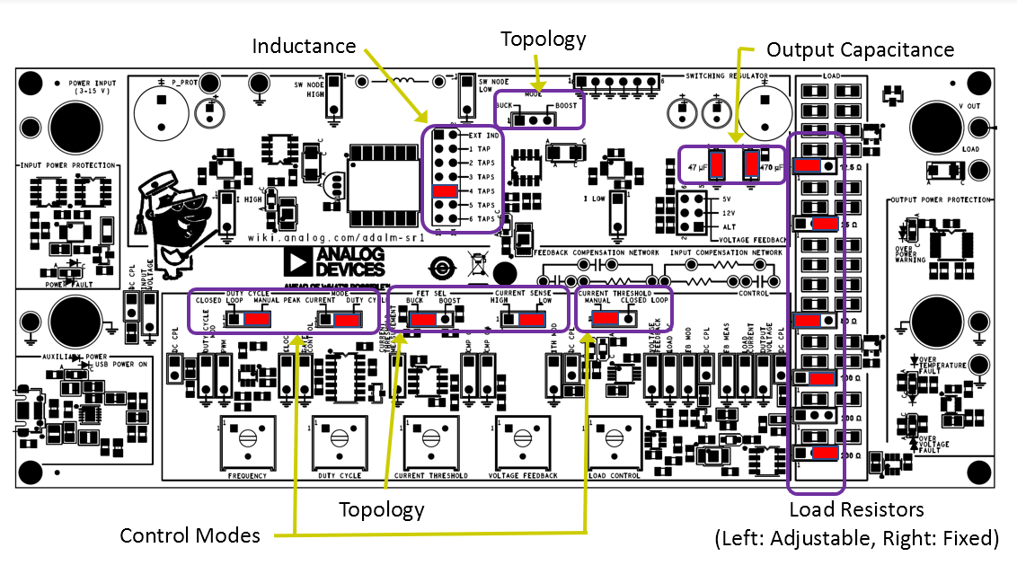
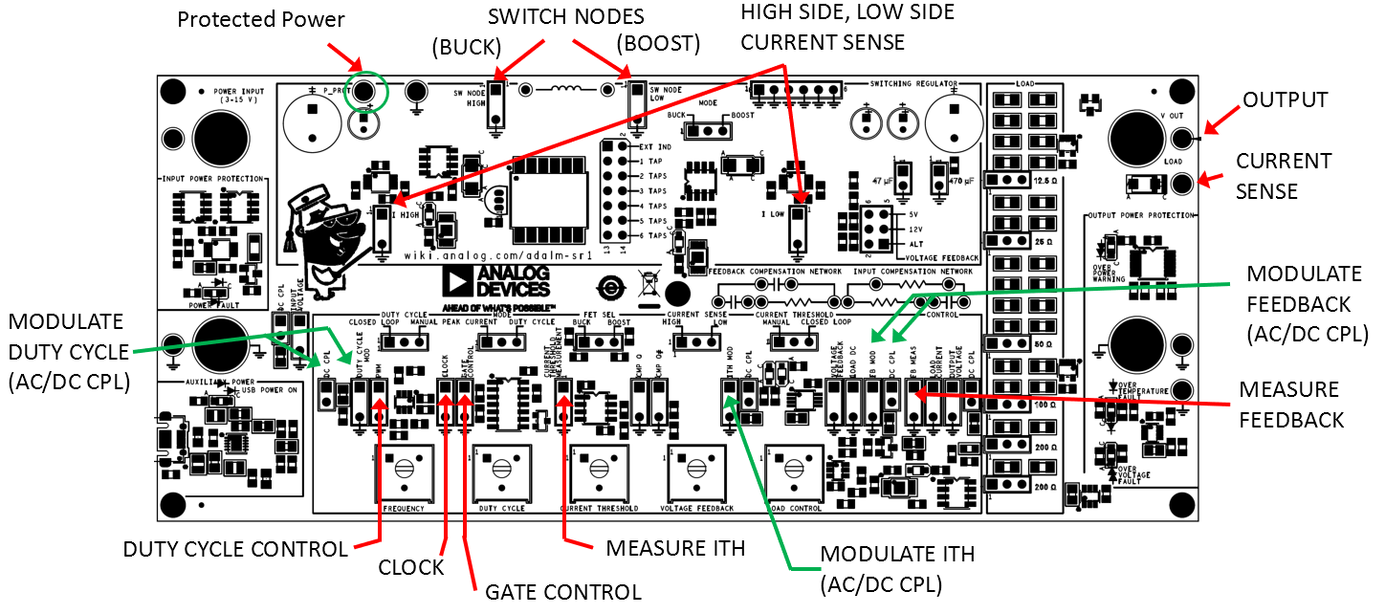
Overview
Built for understanding the converter by examining both the power components, and the signal blocks that is normally not accessible in the controller IC.
V_{IN} = 3-15V, I_{IN(lim)} = 2A, V_{out(max)} = 22-24V
R_{load} = 6.25- 200 Ohm, with PWM for load step
Inductor, Capacitor and Load Resistor are adjustable
Adjustable frequency, and duty cycle.
Has option to operate in either Buck or Boost mode, with choice of either open-loop or close-loop operation.
Adjustable Current threshold, Feedback voltage, and Load control.
Tests are done in situation of possible misconfigurations from user. This is closely done with the activity of SR-1 at the web page. The tests for robustness are:
High Duty Operation for extreme values of Inductor
Different R_{LOAD} test.
Thermal Check for Inductor and R_{LOAD}
Start-up performance
Housekeeping circuit
Notes:
So SR-1 was never meant to deliver the highest efficient around, nor the most accurate reading there is. But that is a good thing for this purpose because the user will know exactly how the flaws affects the circuit.

Slide 3
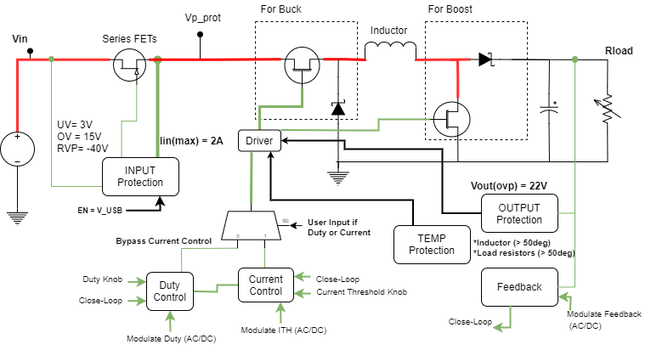
Simplified Diagram and Component Selection
Inductance and Capacitance is larger than typical due to low switching frequency (20KHz on exercises) operation.
Will cause large inductor current ripple especially at 7.7uH
This large inductor current ripple will also limit (or change) our mode of operation.
Other user might see a problem in operation if certain values are not configured properly, due to input current limit, or current threshold limit.
Problem includes subharmonic oscillation, hiccup operation, or failure to regulate voltage.
Capacitors are expected to be large due to low F_{SW}.
Inductance Selection (P3)
Jumper
Position | EXT IND | 1 TAP | 2 TAPS | 3 TAPS | 4 TAPS | 5 TAPS | 6 TAPS
Function | Ext. inductor at TP3, TP4 | 7.7μH | 31.5μH | 72.6μH | 131.5μH | 216.2μH | 313.4μH
Output Capacitors Selection (4.7uF initial capacitance)
Jumper | P8, P11
Position | Installed | Open
Function | P8 connect additional 47μF capacitance | No additional capacitance
 | P11 connect aditional 470μF capacitance | No additional capacitance

Slide 4
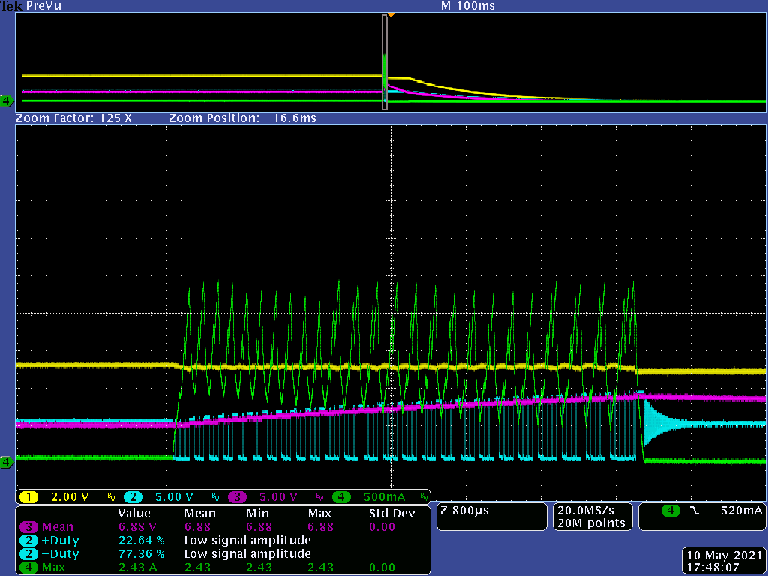
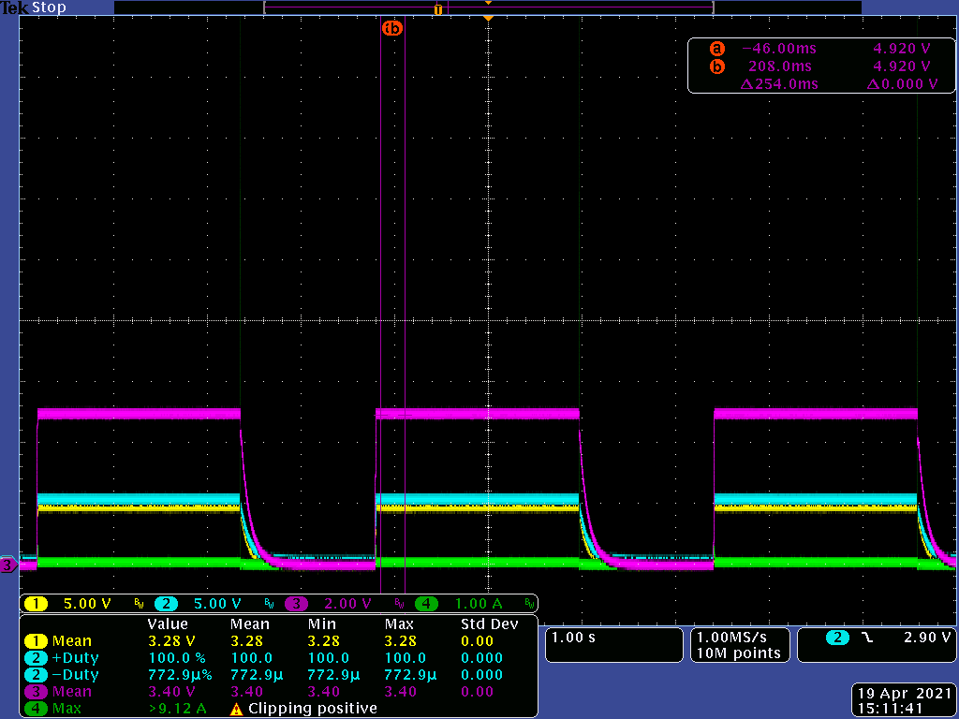
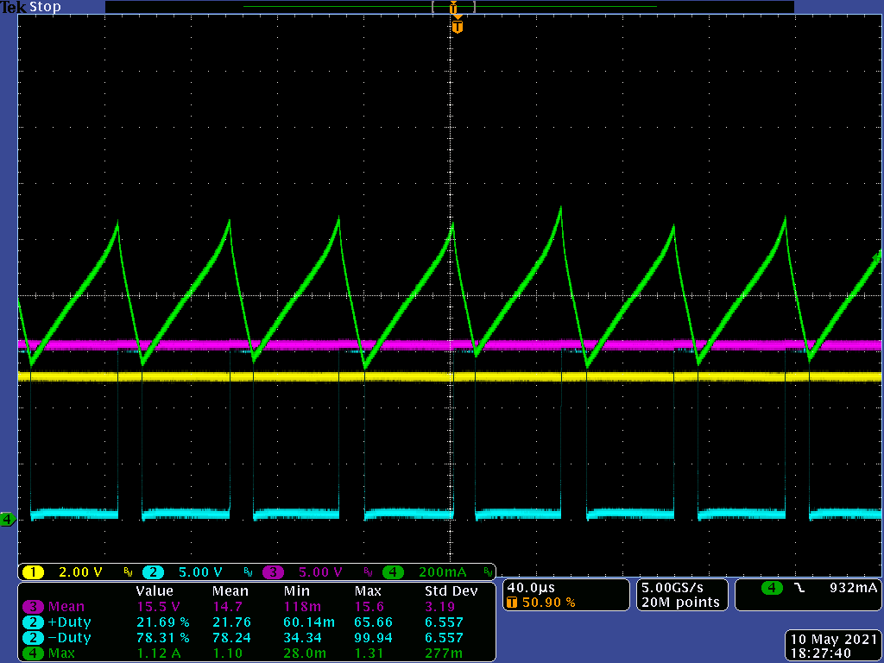
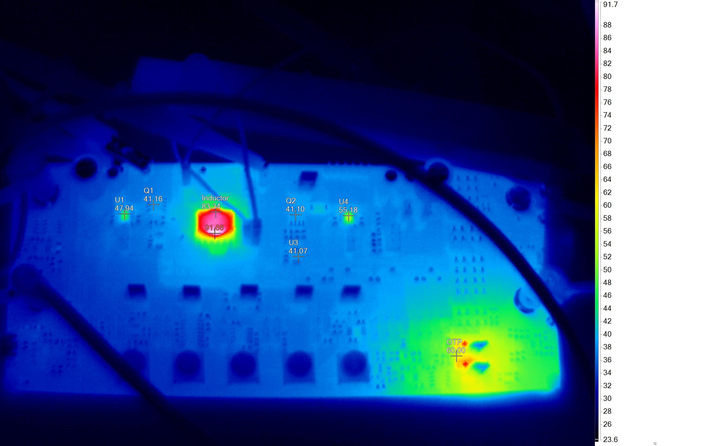
Boost Converter: Open-Loop Max V_{OUT} and Thermal Test V_{IN} = 5V, F_{SW} = 20KHz
L = 7.7uH
Same current threshold
Adjusting Duty Knob to determine maximum voltage possible
Tested beyond suggested duty value at minimum and maximum values of L.
Vprot (yellow) also drops means that series FET turns off
OCP takes over instead of OTP
L = 313.4uH (6 taps), R_{LOAD} = 100 Ohms V_{OUT_measured} = 15.2V Computed V_{OUT} = 20.8V
Inductor showing sign of saturation.
CH1 | Vprot
CH2 | SW
CH3 | Vout
CH4 | IL
Duty = 76%
At low L, over-current trips and no steady-switching occurs.
Inductor heating up starts to reduce effective inductance; prone to saturation
Inductor operates at high inductor temp but still within specs (below 125deg C).
T_{IND} = 91.68deg C
R_{LOAD} = 60deg C
At high L, max voltage is 15.2V Inductor operates at 91deg C.
Notes:
Computed value refers to the activity’s equation Vout = Vin(1/(1-D)) which does not consider any parasitics.

Slide 5
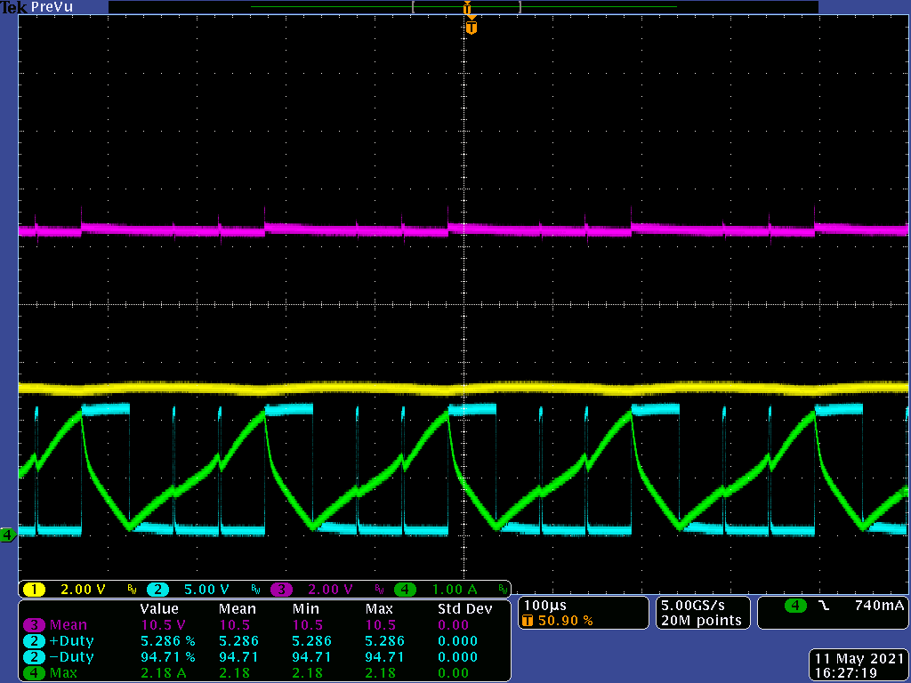
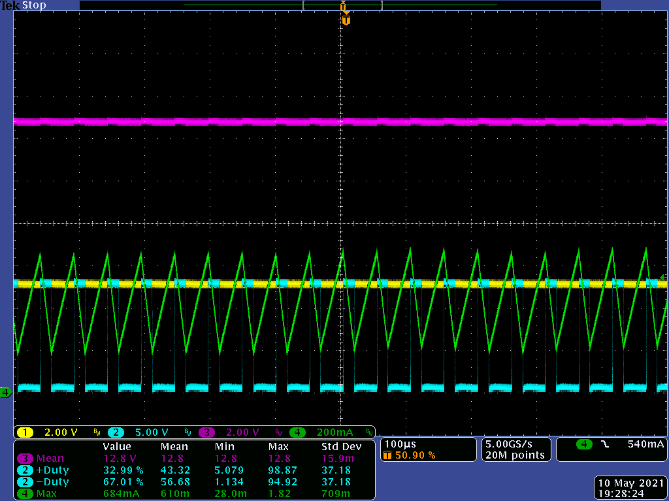
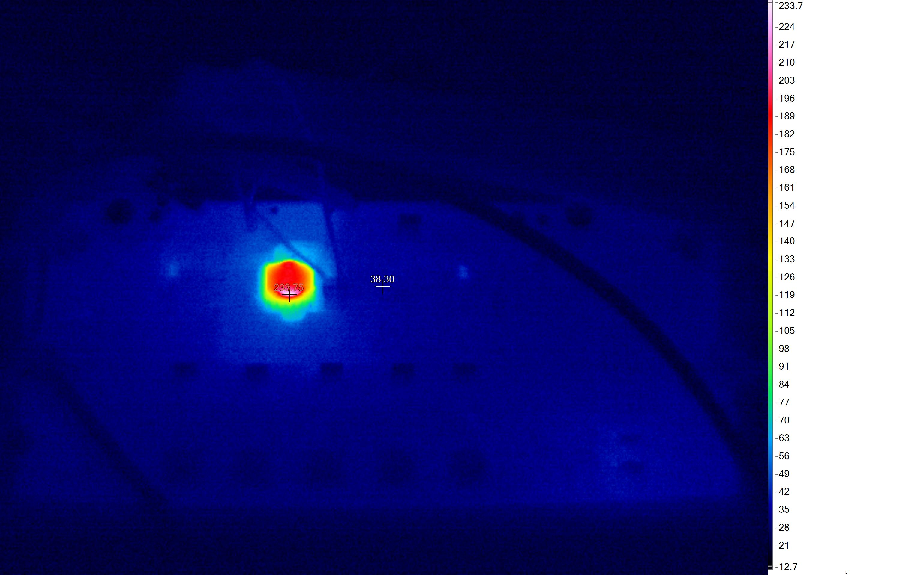
Boost Converter: Max Duty Cycle Knob
R_{LOAD} = 100Ohms
CH1 | Vprot
CH2 | SW
CH3 | Vout
CH4 | IL
During Max Duty Knob
Audible ringing occurs
T_{IND} = 233.75 deg C
Place drop of glue here
After test, inductor is still functional, and the output voltage is within expected range at typical application.
Overtemperature Protection prevents inductor from staying at such high temperature. But temperature still overshoots due to limitation of sensing.
PLACE A DROP OF THICK CYANOACRYLATE GLUE BETWEEN SENSOR AND INDUCTOR
Max Duty Knob makes the Inductor to heat up to 230deg before shutting down with OTP
Hiccup occurs around 100deg but temp continues to drop.
OCP takes over that prevents SR-1 from starting up since Duty Knob is still maxed out and so, there is high input current.
Temp sensor
Inductor

Slide 6
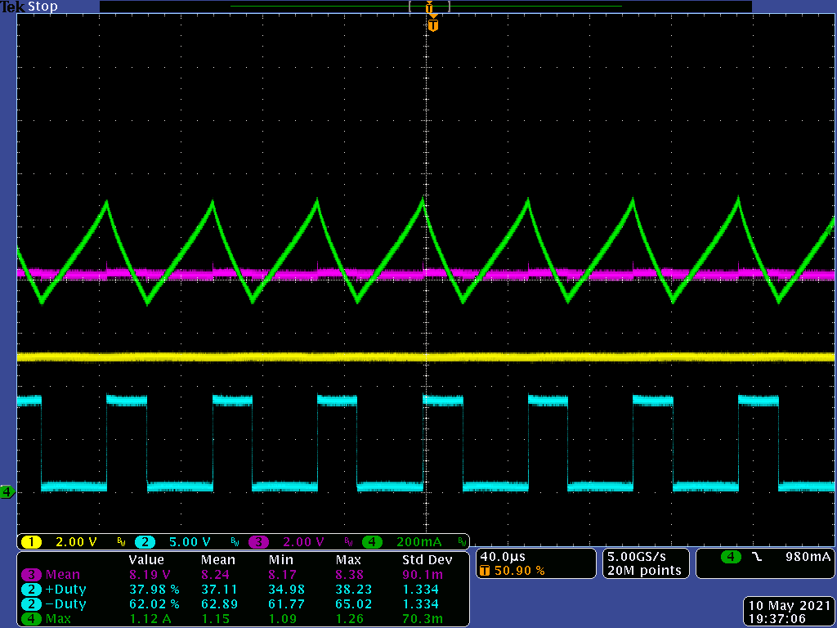
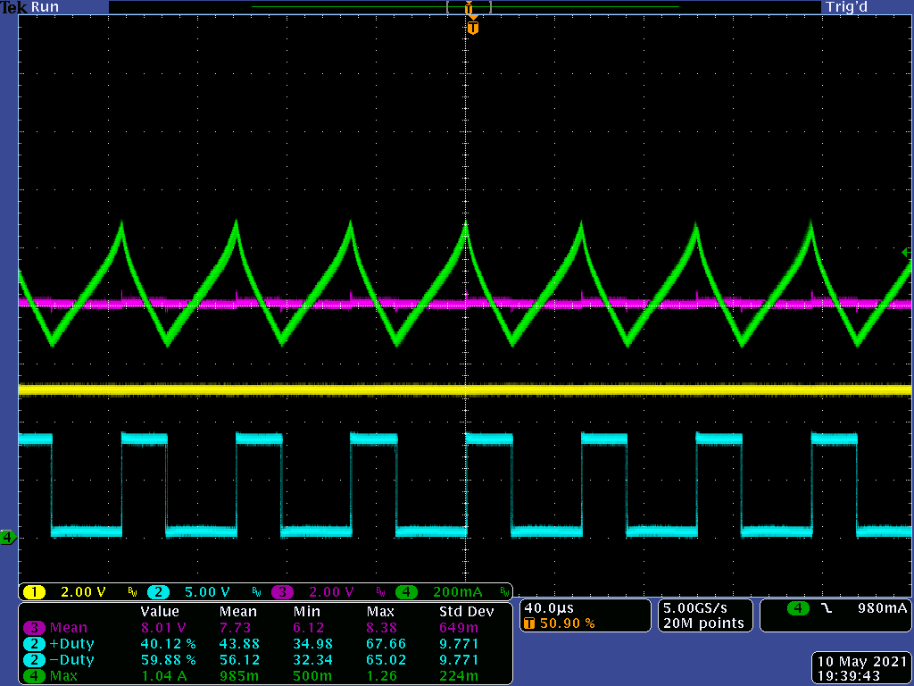
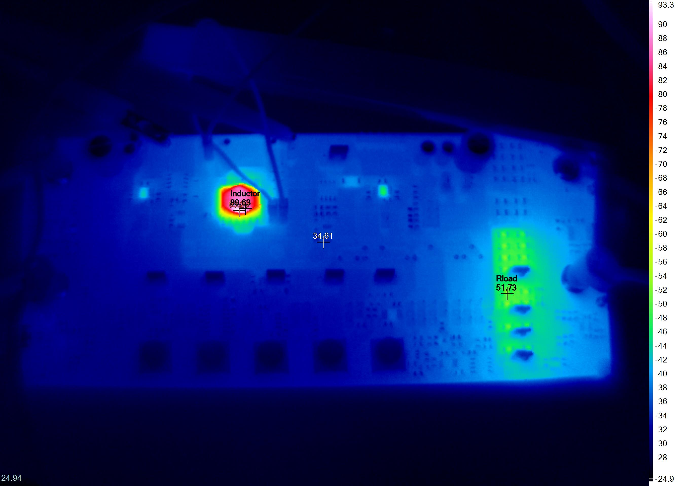
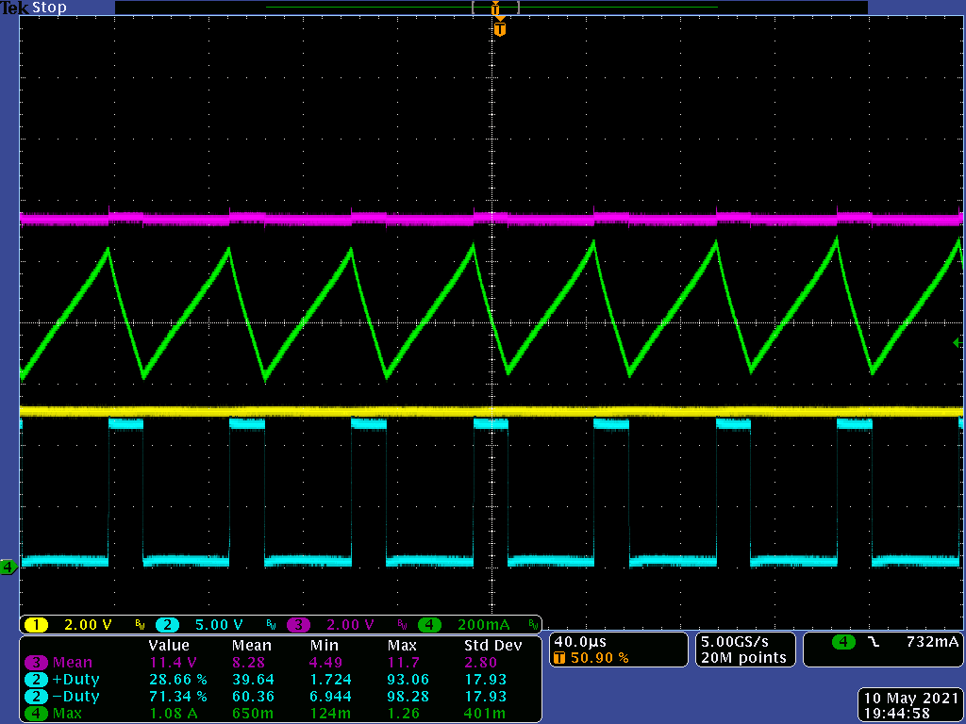
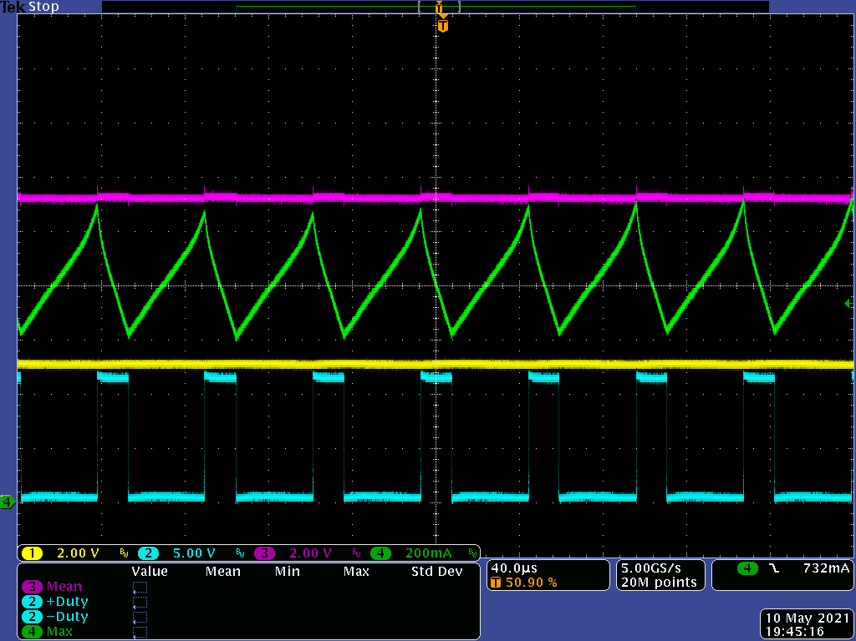
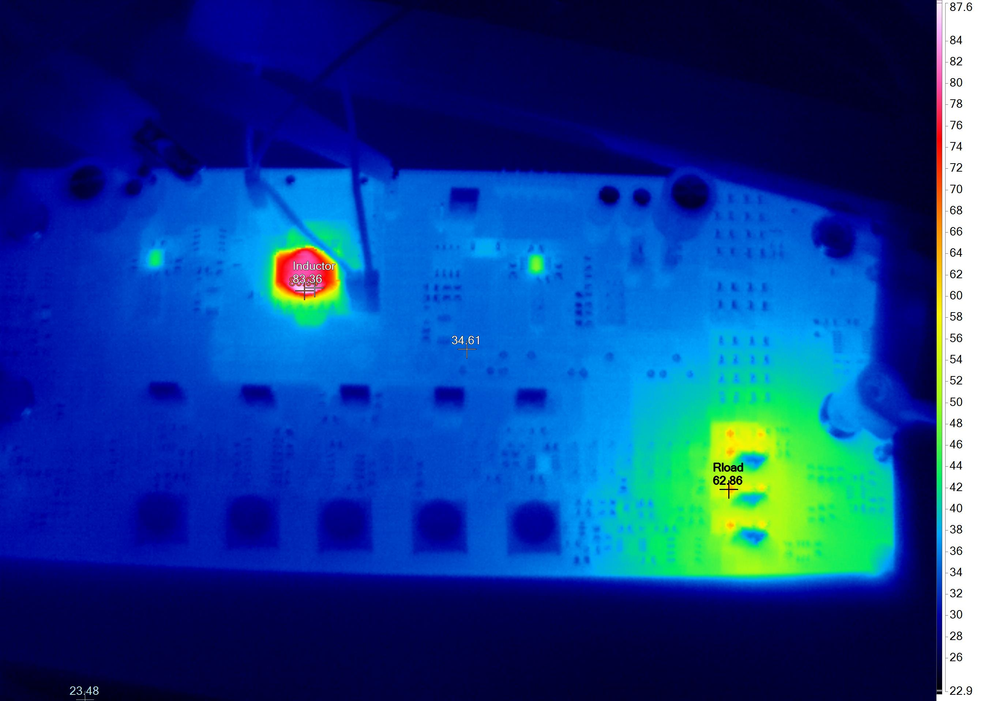
Boost Converter, V_{IN} = 5V, F_{SW} = 20KHz, R_{LOAD} Test
R_{LOAD} = 25 Ohm V_{OUT(max)} = 8.2V
Duty = 61.42% Computed V_{OUT} = 13V
A minute of prolonged exposure
Higher load heats the inductor greatly.
Increasing load (by adding parallel resistors) reduces the heat dissipated in each individual resistors.
Prolonged exposure shows sign of saturation at inductor current.
Inductor @ 93deg, R_{LOAD} @ 51deg
CH1 | Vprot
CH2 | SW
CH3 | Vout
CH4 | IL
R_{LOAD} = 50 Ohm V_{OUT(max)} = 11.3V
Duty = 72.22% Computed V_{OUT} = 18V
Inductor @ 87deg, R_{LOAD} @ 62deg

Slide 7
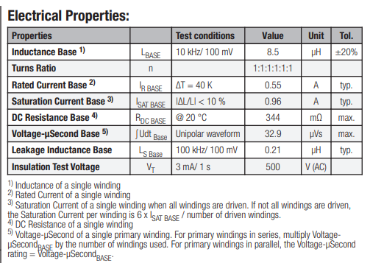
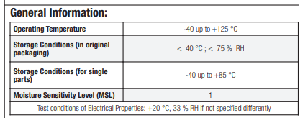
Explanation: Limitation of Output Boost Voltage
Inductor of SR-1
Boost Factor
R_{L} = Inductor ESR
R = Load resistor
At higher R_{L} , the Boost factor is greatly reduced.
V = Output Voltage
V_{g} = Input Voltage
Additional factors that limits Boost Factor: 1. Drop of diode
2. FET’s R_{DSON} 3. Series R_{SENSE}
Notes:
This graph is from Erickson’s book. It shows here that boosting is limited by the ratio of inductor’s ESR and Load. The larger the R_{L} , the small its boosting capability, and might even fail to boost.

Slide 8
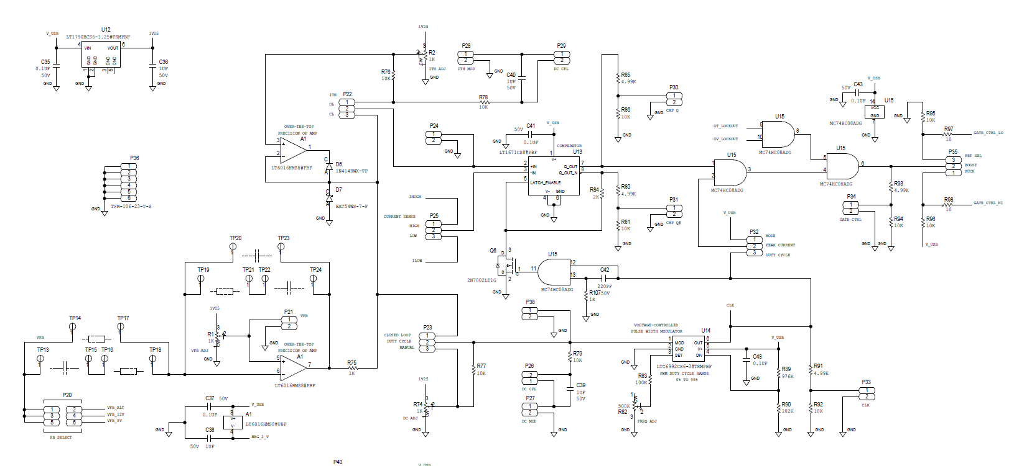
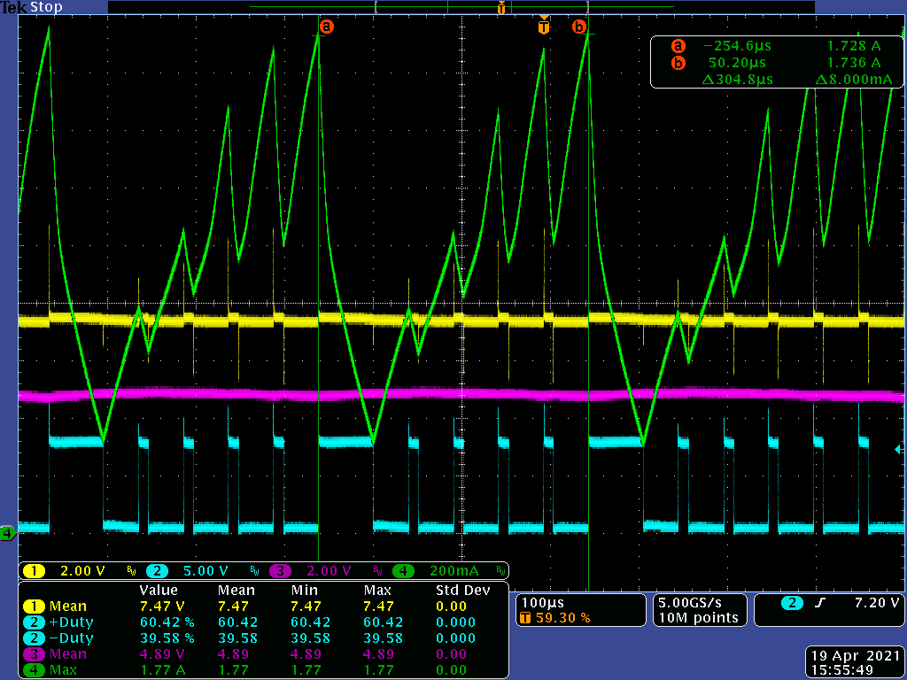
Beyond 50% Duty: Subharmonic Oscillation
V_{IN} = 5V, F_{SW} = 20KHz, L = 313.4uH
R_{LOAD} = 25 Ohm V_{OUT} = 7.5V
Inner loop for Current
Switch Logic (Before Driver)
Subharmonic oscillation
Due to operation without slope compensation especially at higher load current/high duty.
Current threshold allowed is too high.
Voltage EA
Voltage-to-PWM
No Slope Compensation Ckt.
CH1 | Vprot
CH2 | SW
CH3 | Vout
CH4 | IL
Inductor not following Volt-Second Balance
20KHz switching

Slide 9
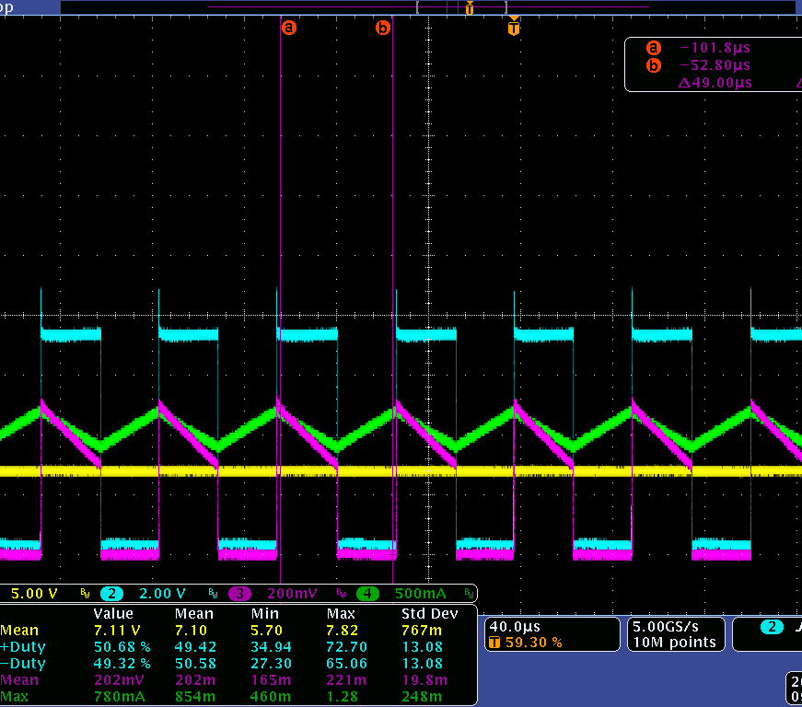
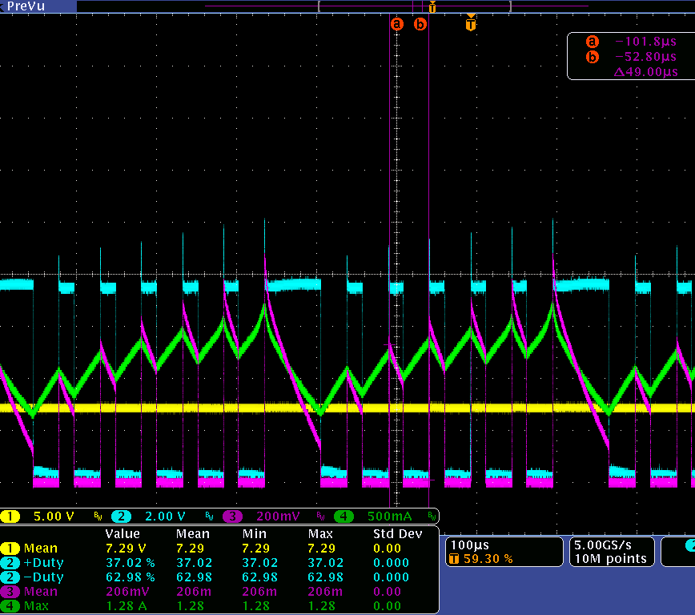
Subharmonic Oscillation (Boost)
Duty below 50%
Duty above 50%
CH1 | Vprot
CH2 | SW
CH3 | Vsense
CH4 | IL
CH1 | Vprot
CH2 | SW
CH3 | Vsense
CH4 | IL
Inductor not following Volt-Second Balance
Steady-state @ volt-second balance
Inductor current follows voltage-second balance every cycle. Inductor current value is the same at start and end of every cycle.
Inductor current rise every cycle and thus contains subharmonic oscillation that produces low-frequency oscillation.
Analog Devices ©2021 Analog Devices, Inc. All rights reserved.

Slide 10
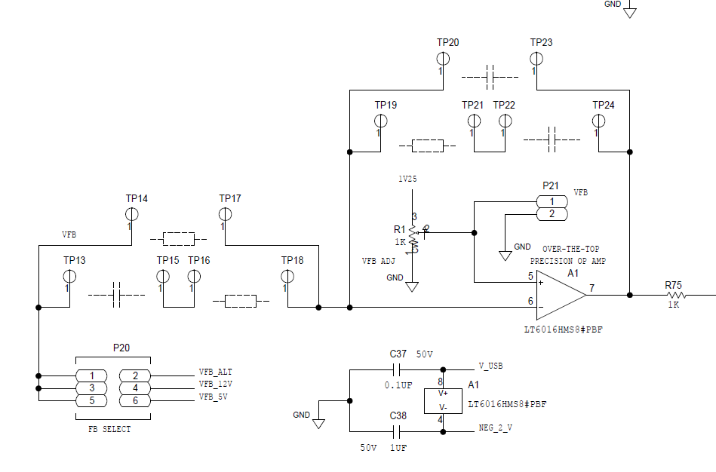
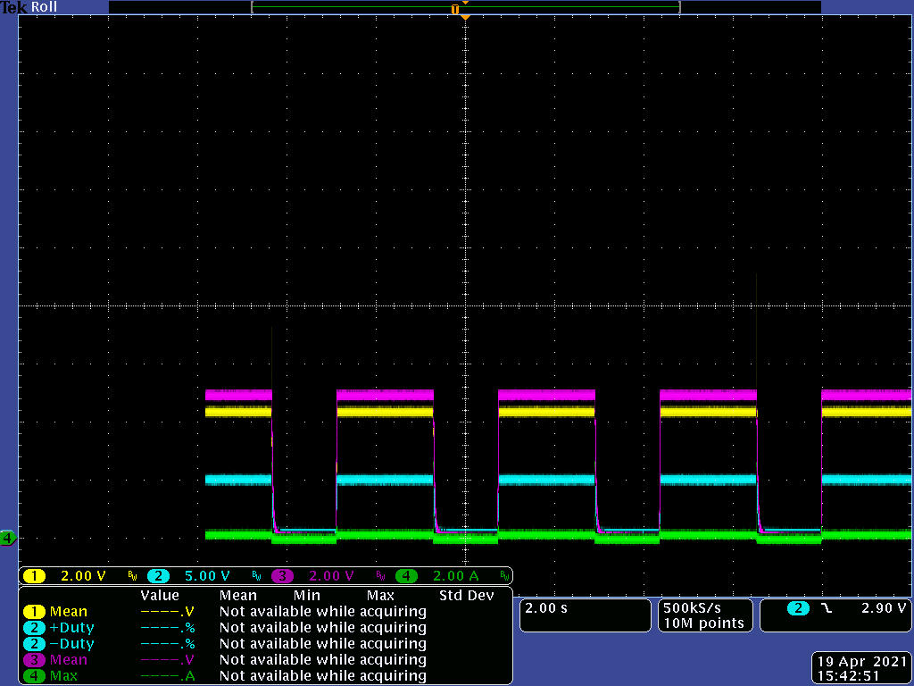
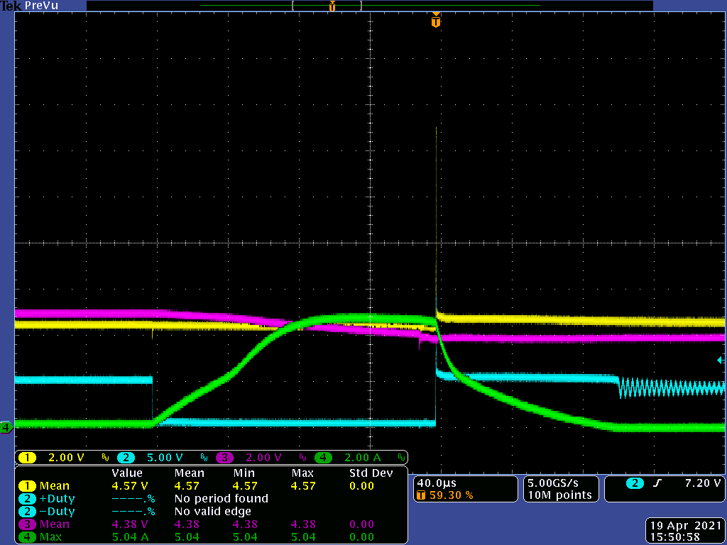
Closed-loop Operation
Device shuts down
CH1 | Vprot
CH2 | SW
CH3 | Vout
CH4 | IL
OCP asserted
Hiccup occurs
Since board is initially unpopulated,
User might accidentally try to operate at Closed-loop operation with feedback being unpopulated.
No further test are done for closed-loop operation
SR-1 shuts down in an event like this to protect itself
Notes:
Closed-loop is not complete yet with bare-boards

Slide 11
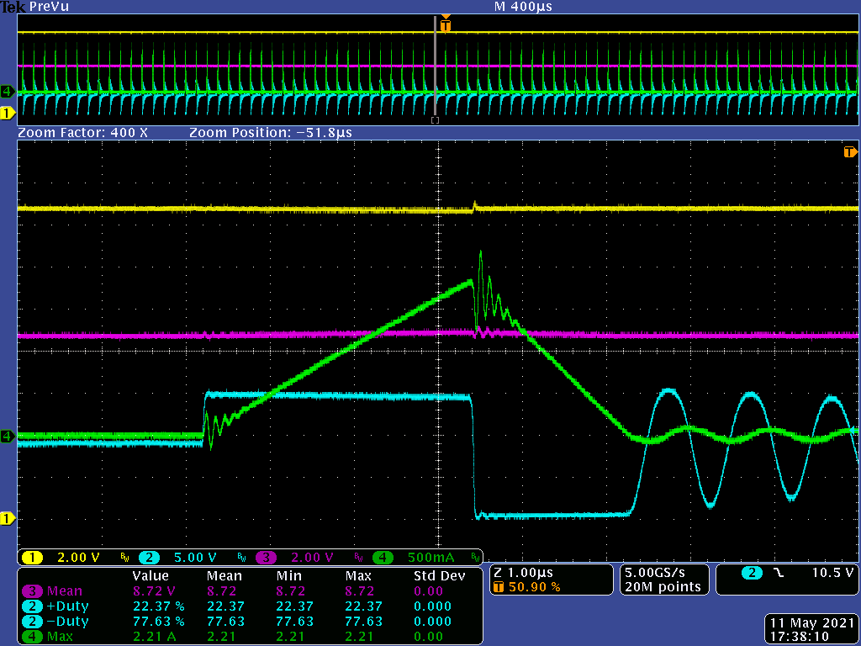
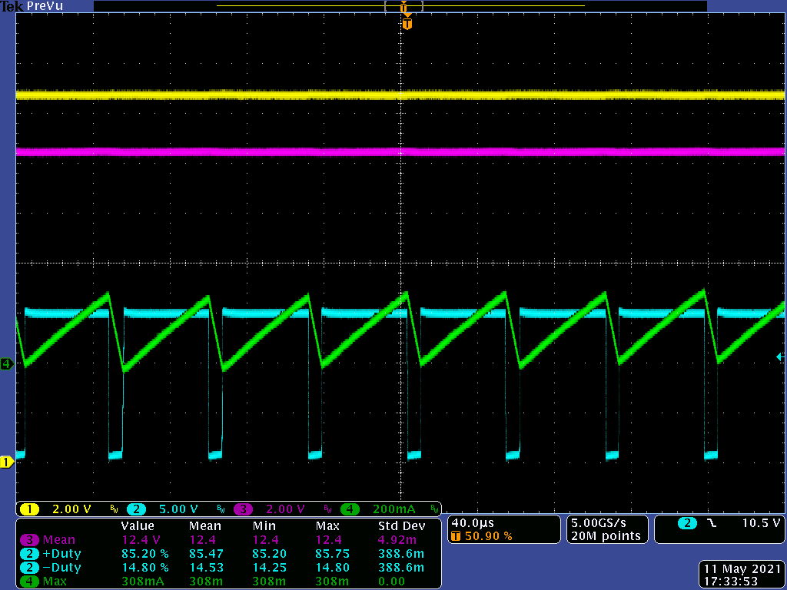
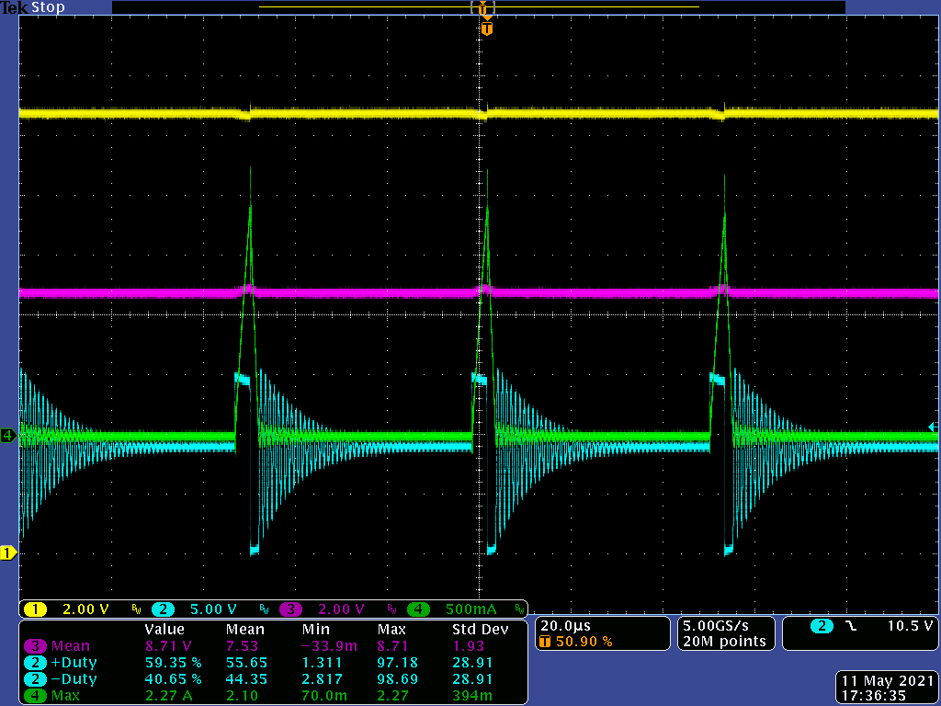
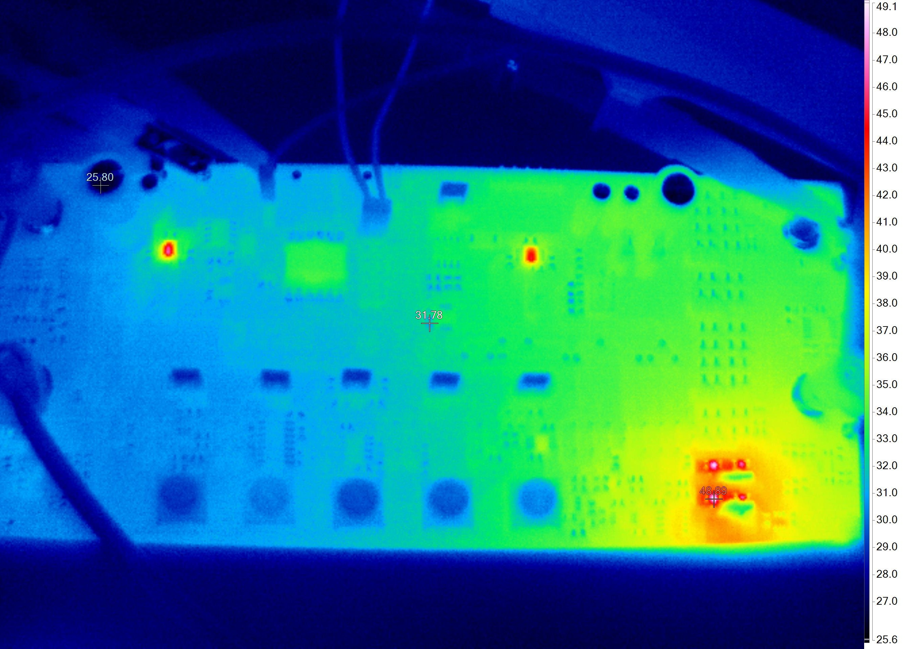
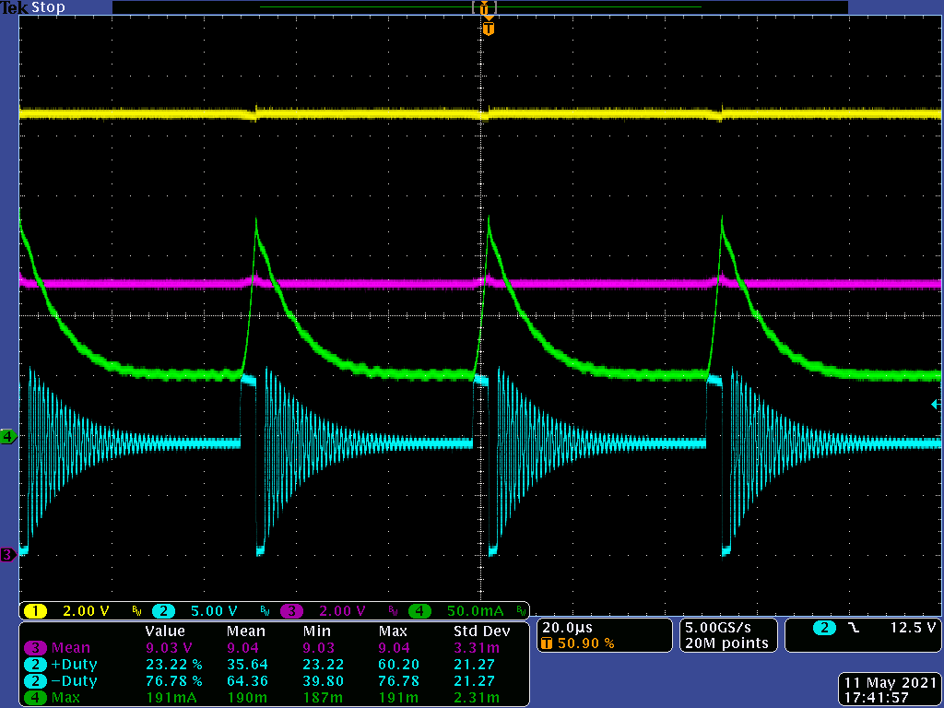
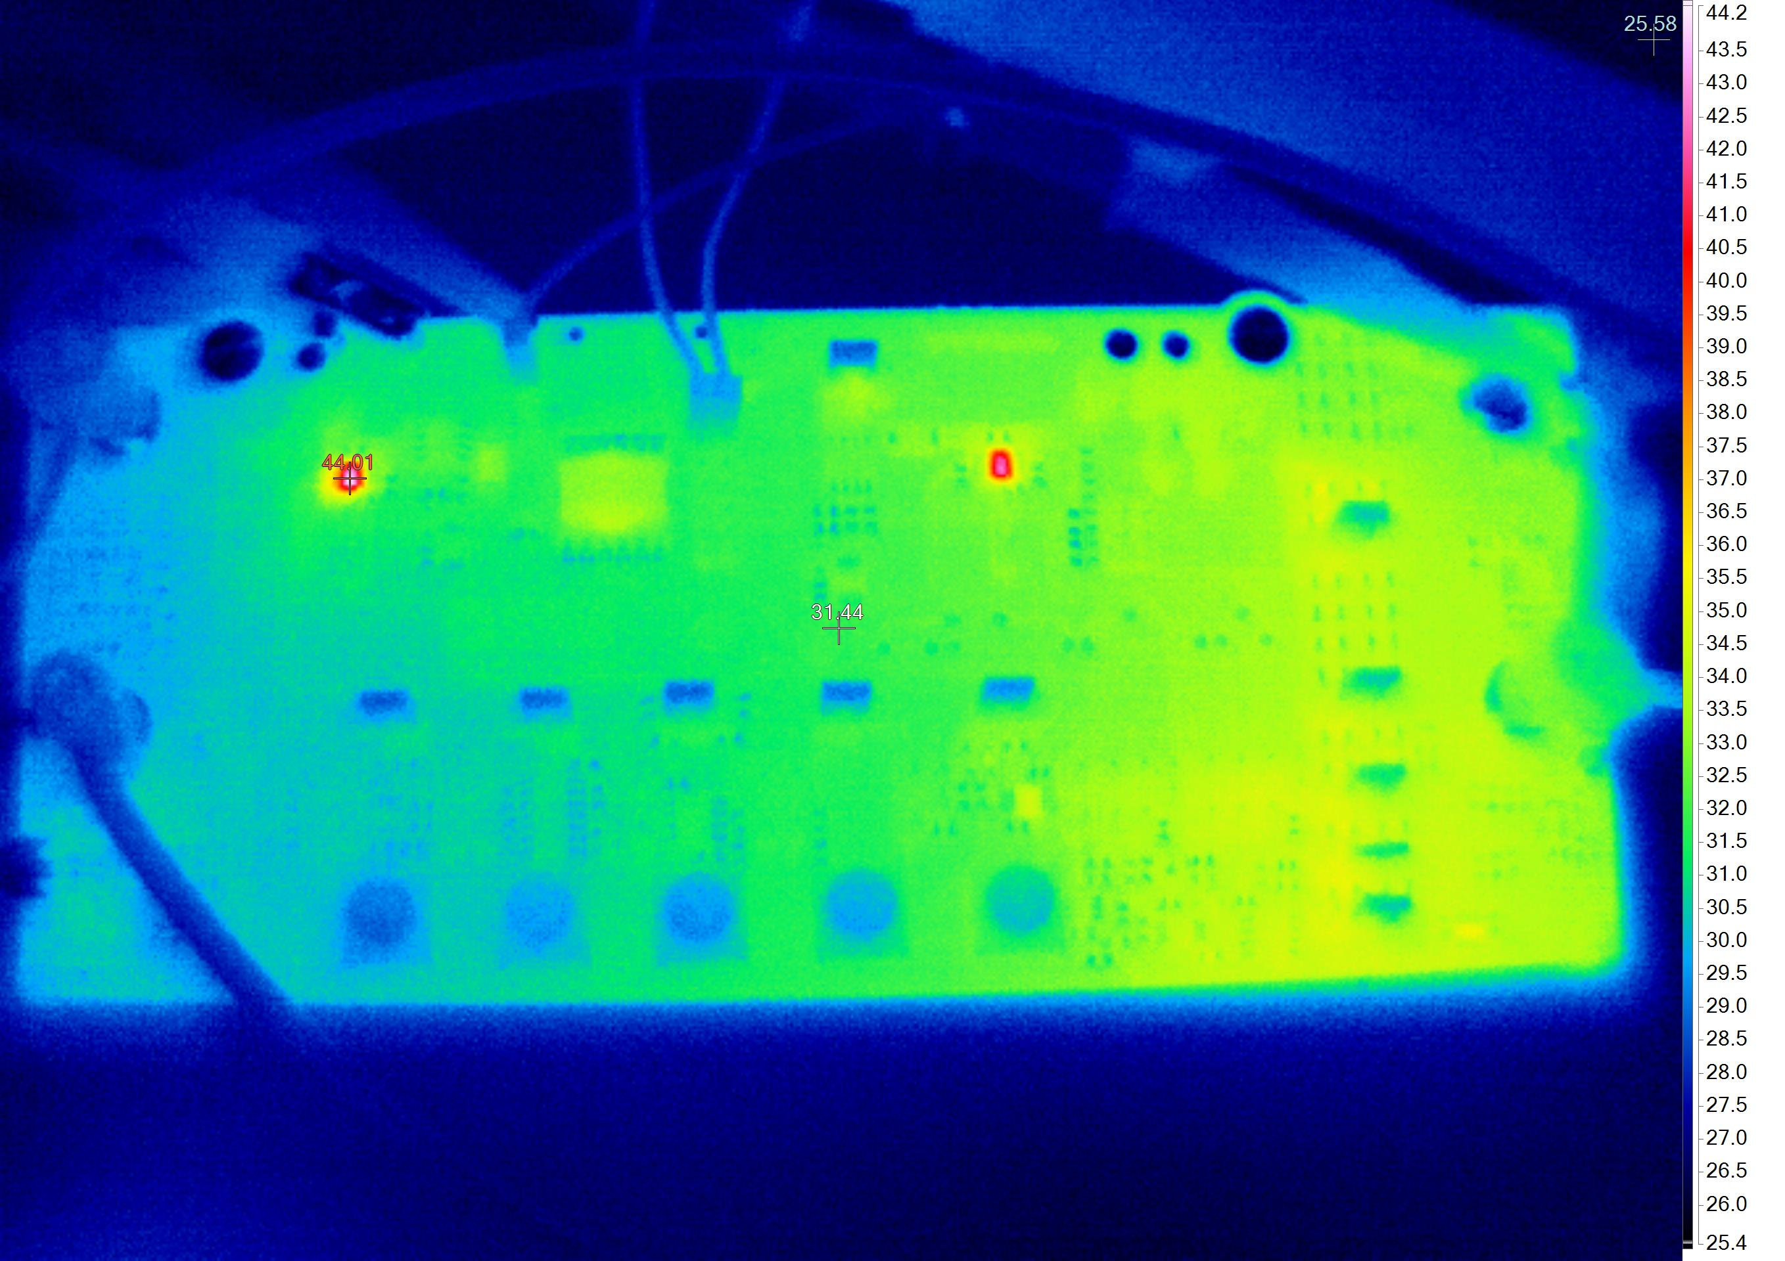
Buck Converter, V_{IN} = 14.5V, F_{SW} = 20KHz, R_{LOAD} = 100 Ohm
L = 313.4uH V_{OUT(max)} = 12.4 V
Duty = 85.2%
Computed V_{OUT} = 12.3
L = 7.7uH V_{OUT(max)} = 8.67 V
Oscillation due to switching.
Does not scale up when inductor current and duty got larger.
Ind. current
CH1 | Vprot
CH2 | SW
CH3 | Vout
CH4 | IL
T_{ind} @ 33deg, R_{LOAD} @ 48deg
Input Current
Mode of Operation turns DCM: V_{OUT} does not follow the ideal CCM voltage conversion ratio.
Load = 100 Ohm
Temperature Sensor
Inductor peak and Input current is still within reasonable range
T_{ind} @ 33deg, R_{LOAD} @ 34deg
T_{ind} is same at L= 7.7uH because Current Threshold limits the peak current.
Prone to heating up
Load = 12.5 Ohm

Slide 12
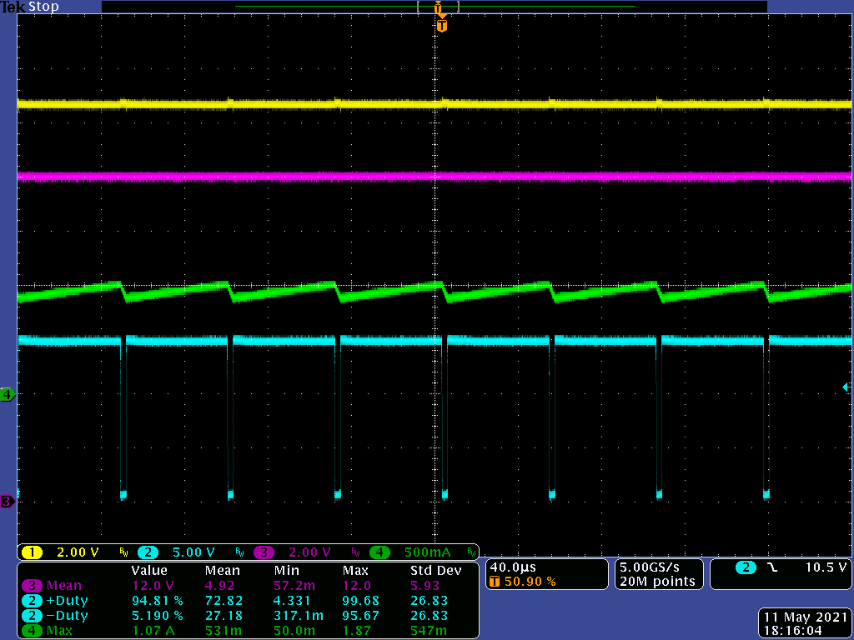
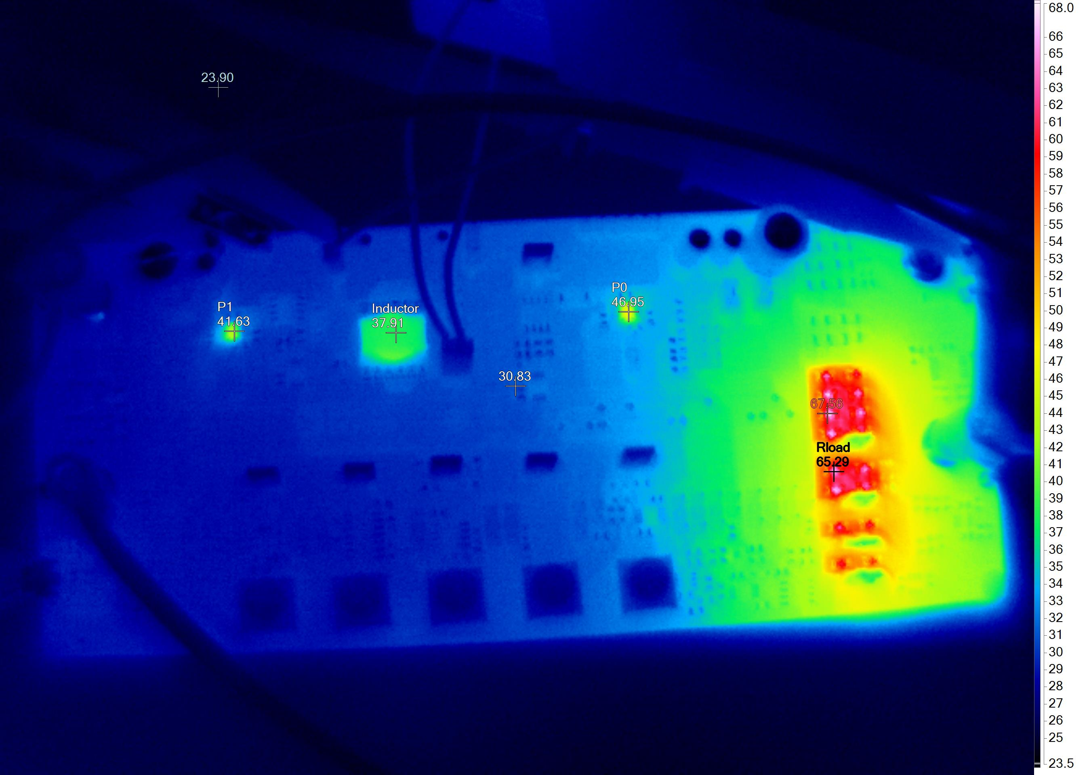
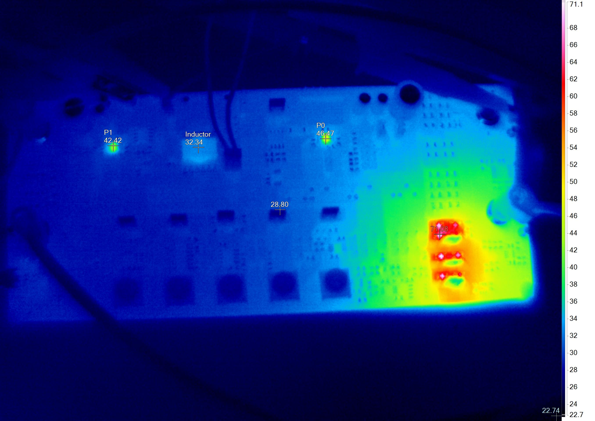
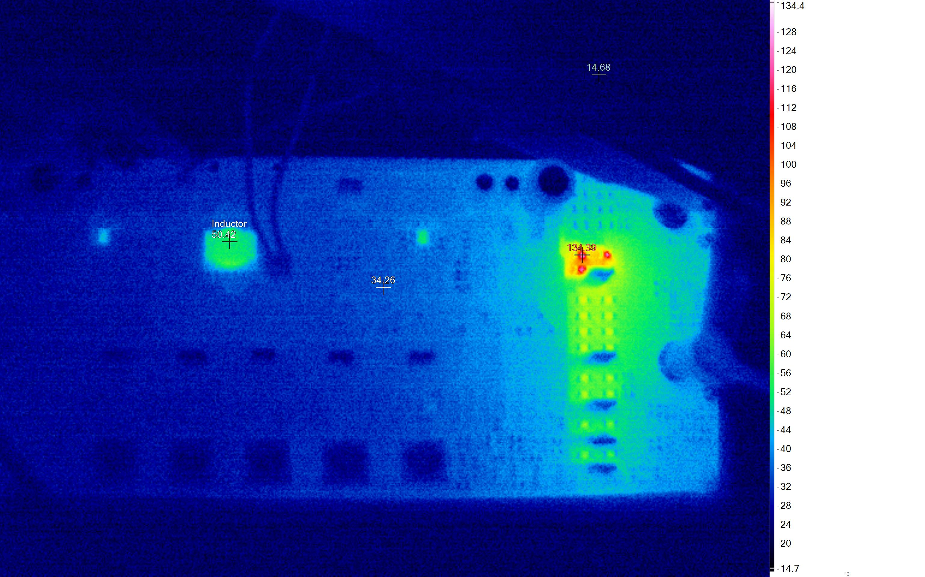
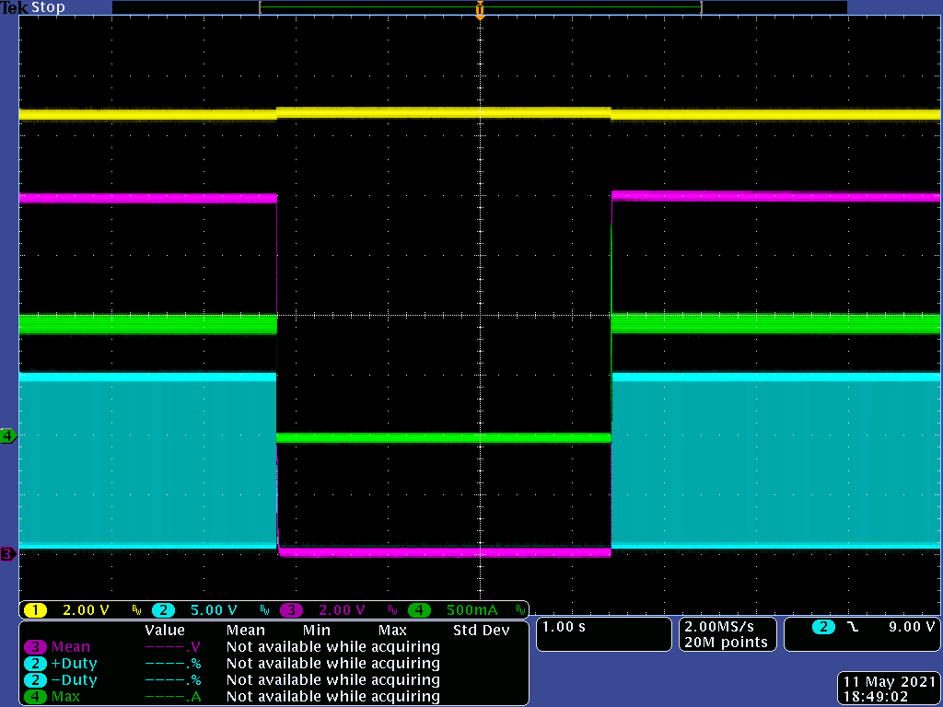
Load Test and Thermal Performance
V_{IN} = 14.5V, F_{SW} = 20KHz, L = 313.4uH
R_{LOAD} = 12.5 Ohm V_{OUT(max)} = 12V
R_{LOAD} = 25 Ohm V_{OUT(max)} = 12.9V
R_{LOAD} = 50 Ohm V_{OUT(max)} = 13.4V
Duty = 94.8%
Duty = 94.78%
Duty = 94.83%
CH1 | Vprot
CH2 | SW
CH3 | Vout
CH4 | IL
T_{ind} @ 32deg, R_{LOAD} @ 71deg
T_{ind} @ 37deg, R_{LOAD} @ 65deg
Waveform @ 25, 50Ohm is the same for R_{LOAD} at 12.5Ohm.
OTP goes into hiccup after some time (when R_{LOAD} Temp < 50deg)
The inductor is not as stressed as does in Boost Converter for the given loads. But it is still prone on reaching OTP for heavier load.
R_{LOAD} has the highest temperature across the board. Some resistors are far from sensor.
Hiccup is 3.65s
T_{ind} @ 50.4deg, R_{LOAD} @ 134.3deg
Minimum off-time is around 5% of 20KHz
Notes:
Add thermal

Slide 13
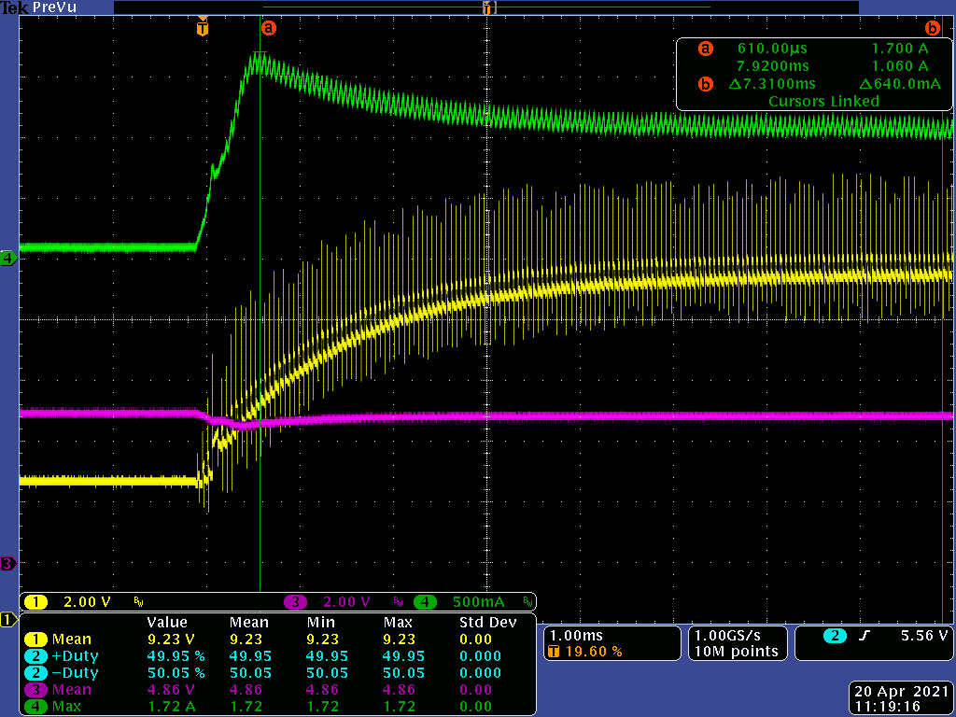
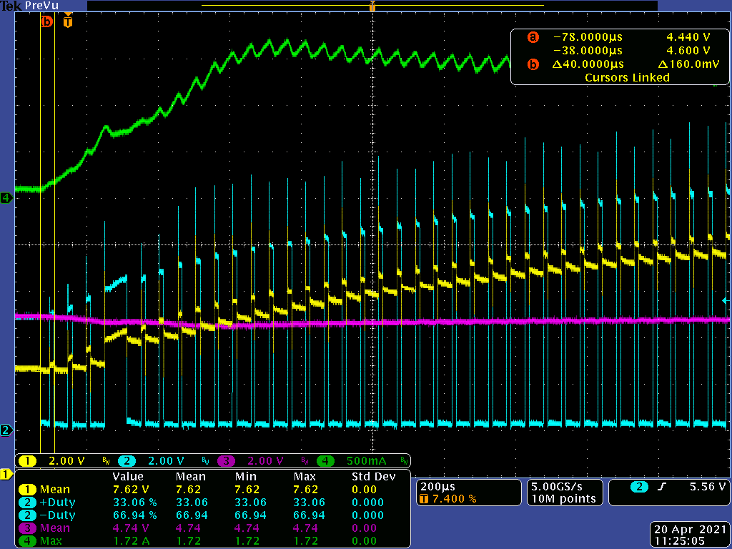
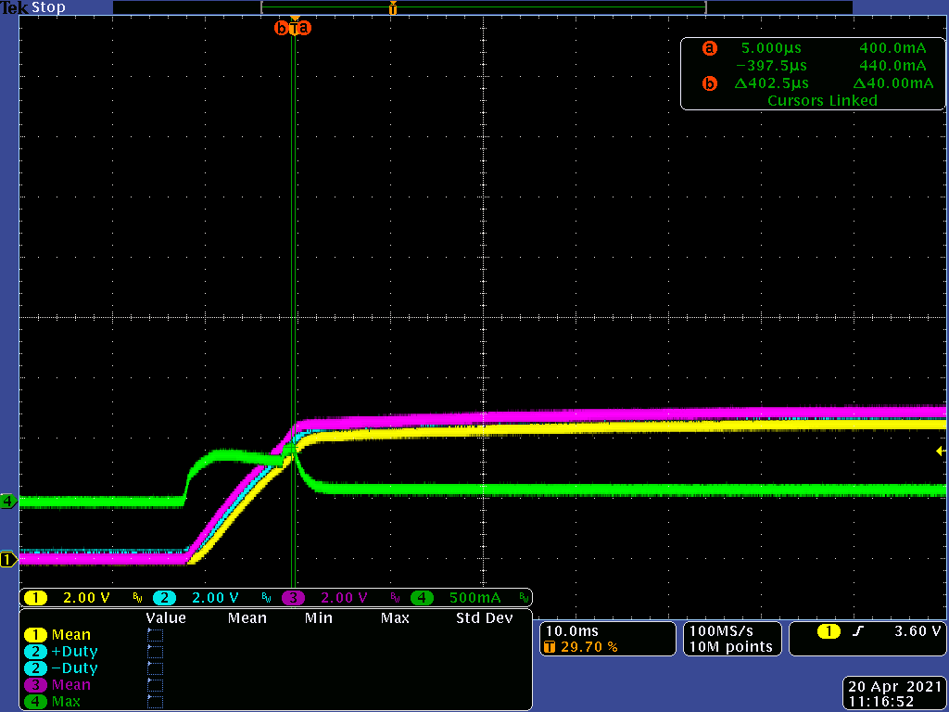
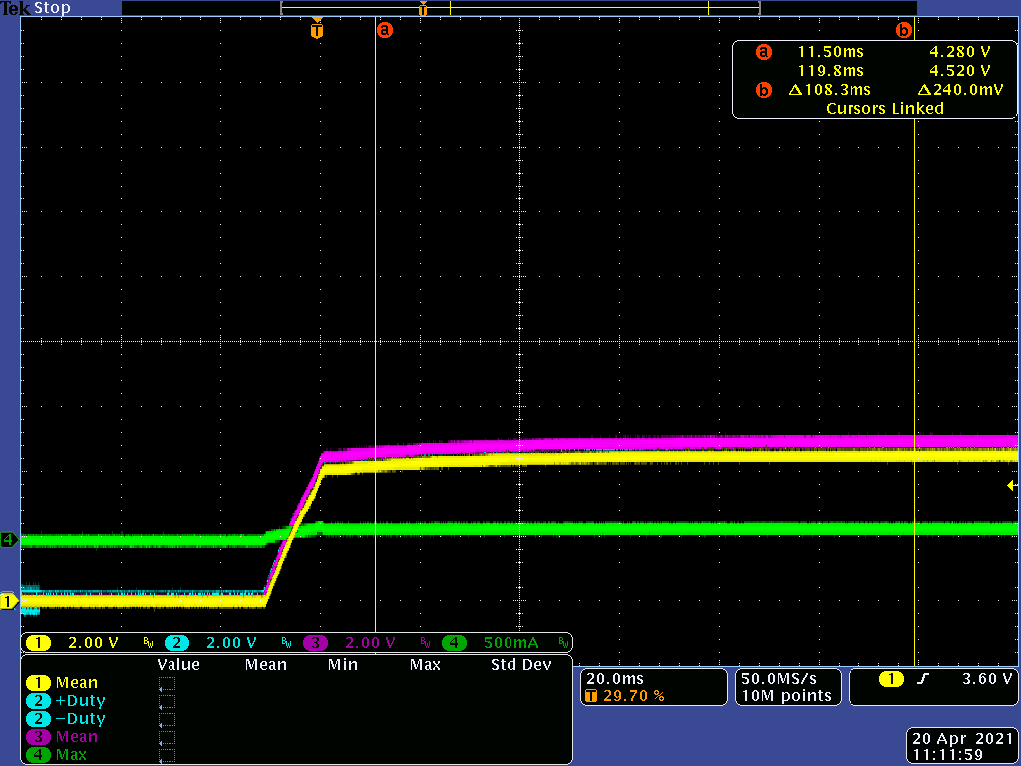
Boost Start up
V_{IN} = 5V, V_{OUT} = 12V, R_{load} = 50 Ohm
CH1 | Vout
CH2 | SW
CH3 | Vprot
CH4 | IL
Vprot drop due to series FET and Rsense when I_{L} pulls current
Has 2 seconds delay from V_{in} power up.
Noticeable overshoot on inductor current but it is below the input current limit.
Startup Switching also occurs at F_{SW} (20KHz)
CH1 | Vout
CH2 | SW
CH3 | Vprot
CH4 | Iin
Input current rush at C_{out} = 4.7uF + 47uF + 470uF
I_{IN} ~= 500mA

Slide 14
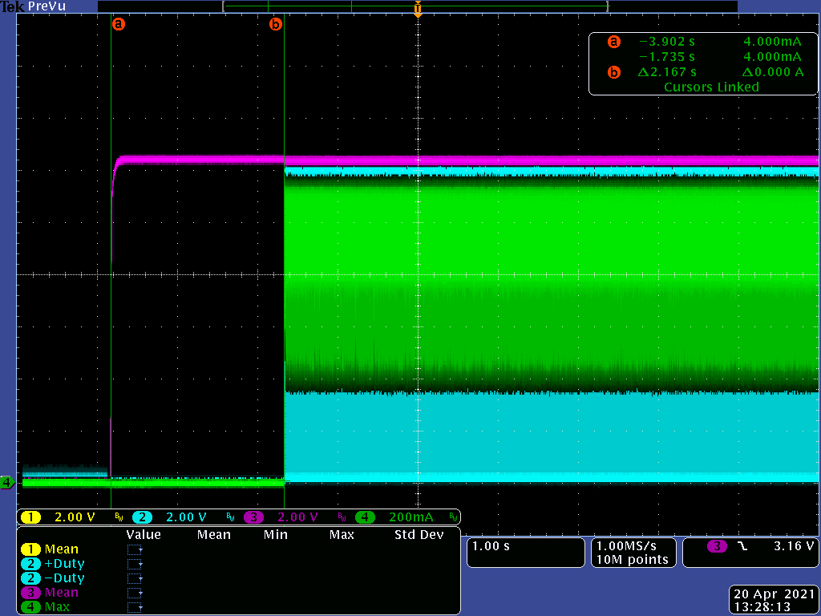
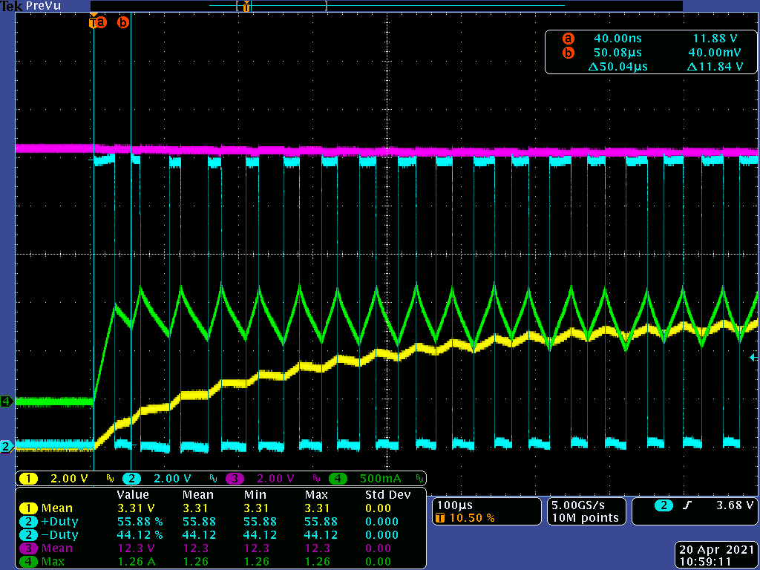
Buck Start-up
V_{IN} = 12.5V
R_{load} = 6.25 Ohm
Switching starts at set F_{SW}
Start-up Duty is same as SS Duty
No large current overshoot
Switching delayed by 2.1 seconds.

Slide 15
Housekeeping Circuit
Main Components:
LTC4368 - 100V UV/OV and Reverse Protection Controller with Bidirectional Circuit Breaker Monitors input OVP, reverse protection, and input current limit.
LTC2912 - Single UV/OV Voltage Monitor Monitors temperatures, Output OVP. Will only turn on after USB_PWR is connected.
LT1017 - Micropower Dual Comparator
Input UVP – 3V
Input OVP > 14.5V
Current Limit > 2A RVP –> -40V

Slide 16
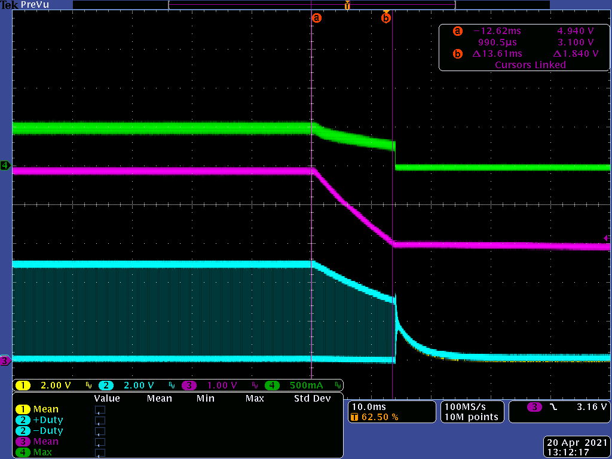
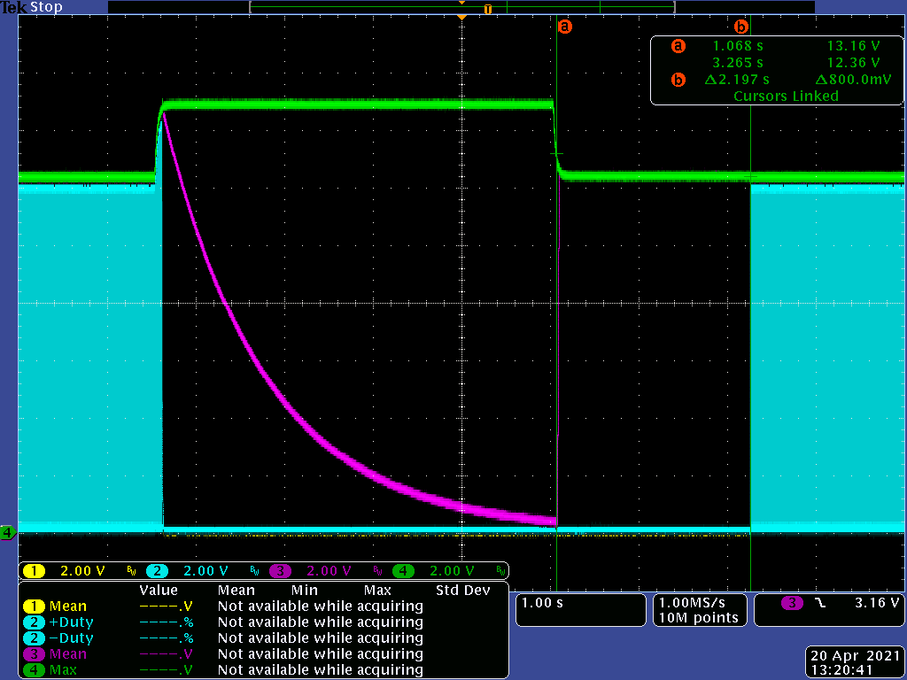
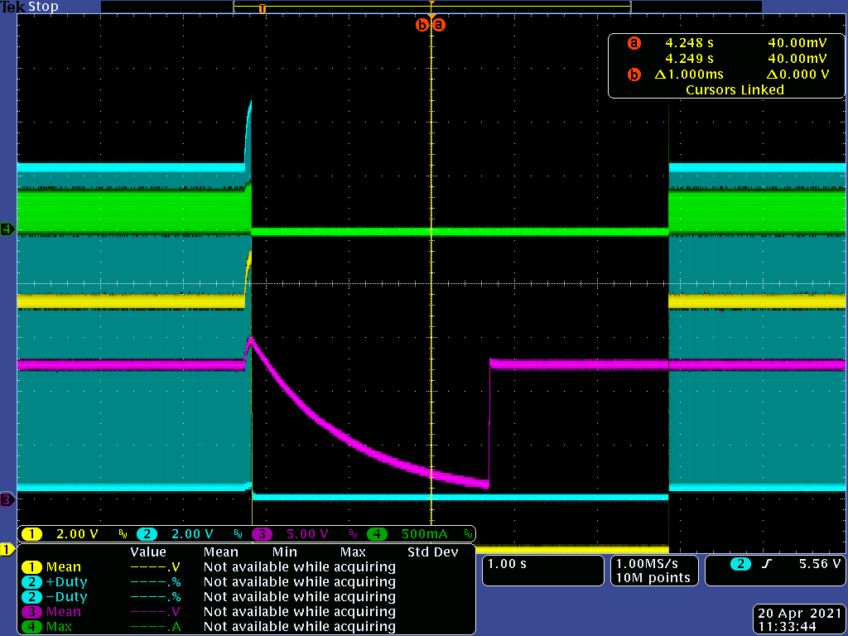
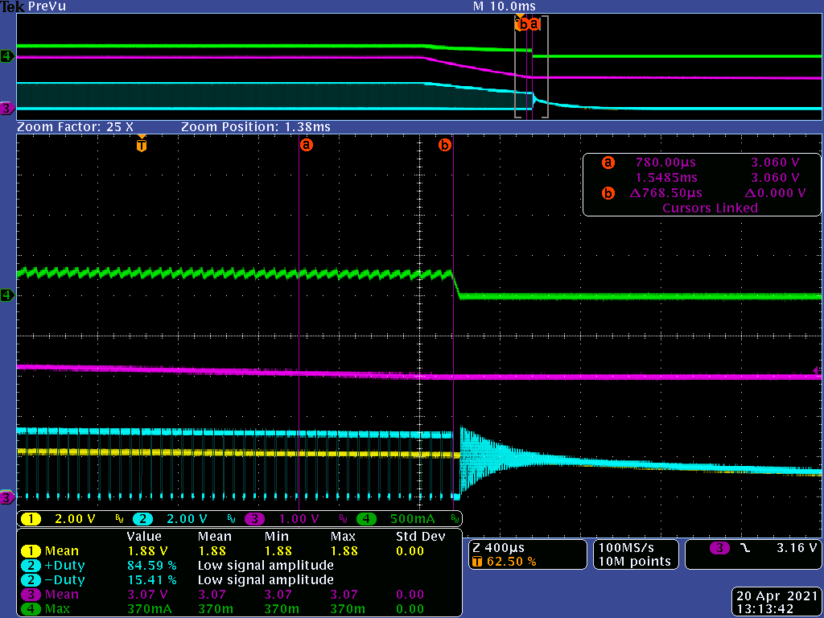
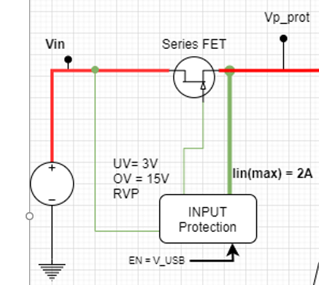
Input Voltage Protection
CH2 | SW
CH3 | Vin
CH4 | IL
Input OVP
Input Voltage rises to 15V.
V_{p_prot} is the voltage after the series FET (Converter Input).
Inductor current reduces to 0.
V_{p_prot} falls when switching stopped.
Converter initiated another start-up (2s delay) after restoring to nominal voltage level.
Input UVLO
Input Voltage falls to 3V.
Switching stop at 3V
Inductor current decay to 0.
No apparent issue on turn off.
CH2 | SW
CH3 | Vprot
CH4 | Vin
CH1 | Vout
CH2 | SW
CH3 | Vprot
CH4 | IL

Slide 17
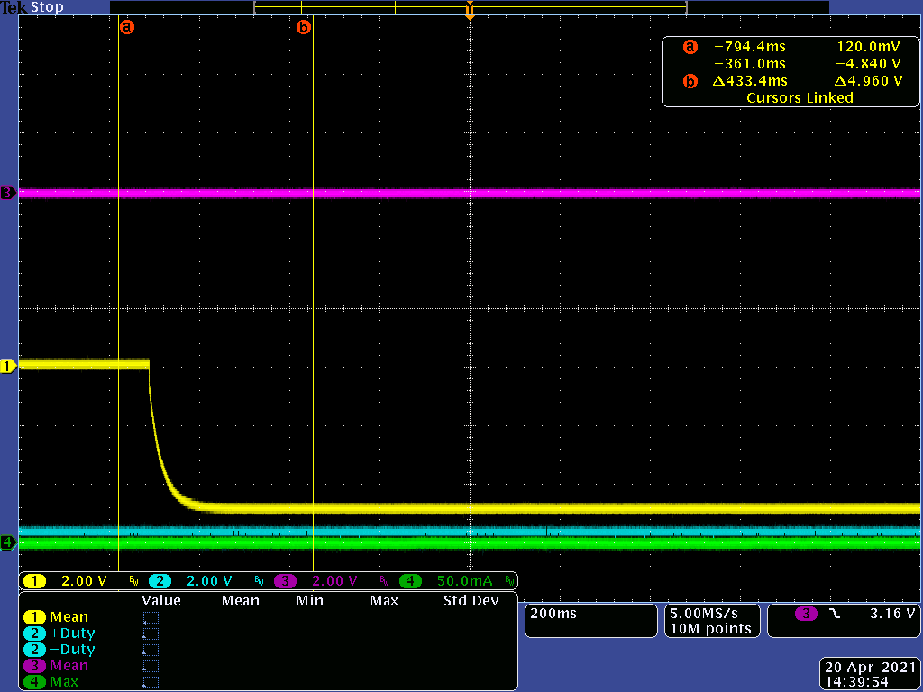
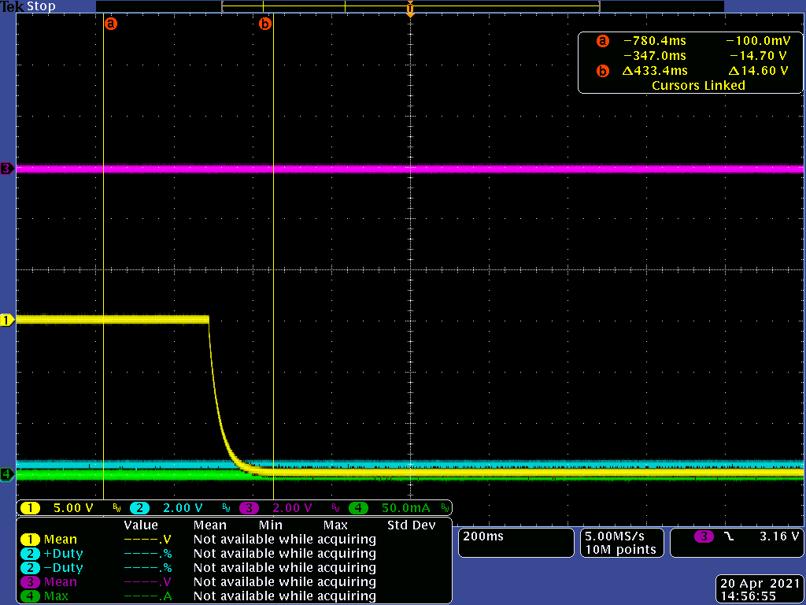
Reverse Input Voltage Protection
Reverse Voltage Protection
Input voltage goes to -5V.
Input current remains relatively zero.
V_{p_prot} has no voltage, which indicates that the series FET is open.
No switching occurs
CH1 | Vin
CH2 | SW
CH3 | Vprot
CH4 | Iin
RVP at -15V
This will happen if user accidentally reversed at maximum input voltage
CH1 | Vin
CH2 | SW
CH3 | Vprot
CH4 | Iin
RVP protects SR-1 and no current flows to the rest of circuit

Slide 18
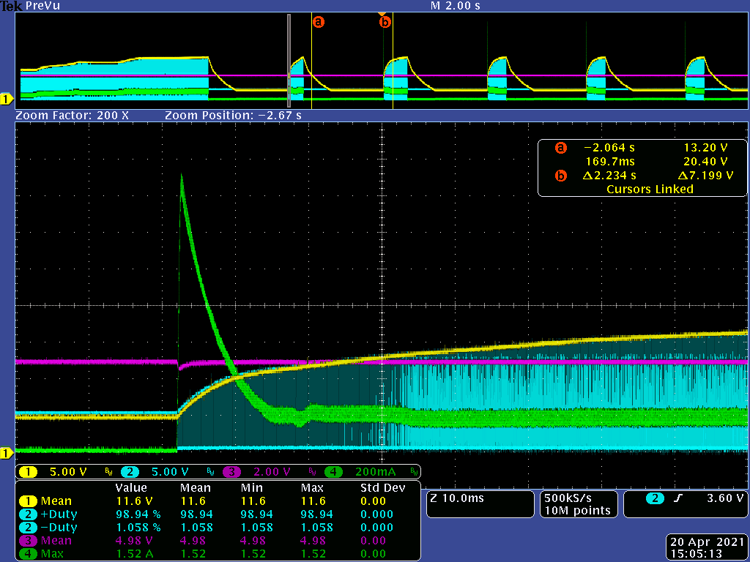
Output OVP
CH1 | Vout
CH2 | SW
CH3 | Vin
CH4 | IL
Input current peak at 1.52A. (Below OCP) during start-up.
Output OVP occurs at Boost Mode. With no load, at high duty cycle setting.
Output OVP is set at 22V.
Hiccup occurs every 2 seconds.

Slide 19
Conclusion
ADALM SR-1 provides an excellent initial experience for user to learn typical circuits for a Switch-Mode Power Supplies.
Performance is far from typical PMIC especially at extreme cases, but it is emphasizing the effect of each parameter (such as losses, duty cycle limit) and other typical circuit blocks.
User will have no problem to work on its typical application.
Intermediate topic such as slope compensation (in Current-mode Control) and soft-start circuit (for start-up profile) could provide additional insights for next revisions.
Although SR-1 can protect itself against over-temperature, temperature overshoot still exists due to delay in sensed temperature and actual temperature of the devices. The most vulnerable component against temperature is the inductor for Boost and R_{LOAD} for Buck.
SR-1 is tested on different fault and proves that it can tolerate possible misconfigurations from user, thanks to its robust housekeeping circuit.

