Slide 1
Hands-on Workshop: Buck Converter Basics
Presented by:
<<Presenter’s name>>
<<presenter’s title>>
Notes:
10/7/2018

Slide 2
Outline
Buck Basics Lab Exercise
Buck Converter Basics: Waveforms, PWM/Vin/Vout relationships
Closing the Loop

Slide 3
Buck Basics Lab Exercise
A wise old mechanical engineer, when presented with a 24-bit Analog to Digital converter, once said: “I want to understand this. Can I make a model out of one out of wood, on my lathe?”
In contrast, we CAN piece together a working buck converter from discrete parts.
Lab URL: https://wiki.analog.com/university/courses/electronics/buck_converter_basics
Materials Required:
ADALP2000 Parts Kit
** OR **
ADALM-BUCK-ARDZ board
Arduino Uno (or compatible clone) and USB cable
Install LTspice
Install Arduino IDE
Recommend working in groups of 3
Print Out (slides with “Print Me” at the top):
Pictorial and schematic, double-sided
Data worksheets

Slide 4
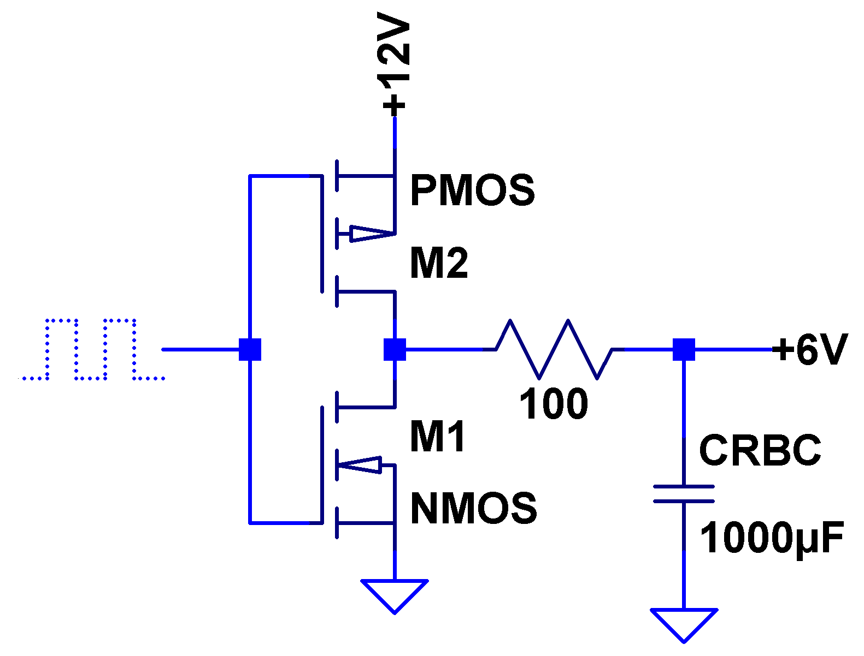
Alternative to an LDO for converting a high voltage to a low voltage:
50% duty cycle square wave
This works, but let’s discuss output impedance, load regulation, efficiency… what do you think?
RBC = Really Big Capacitor

Slide 5
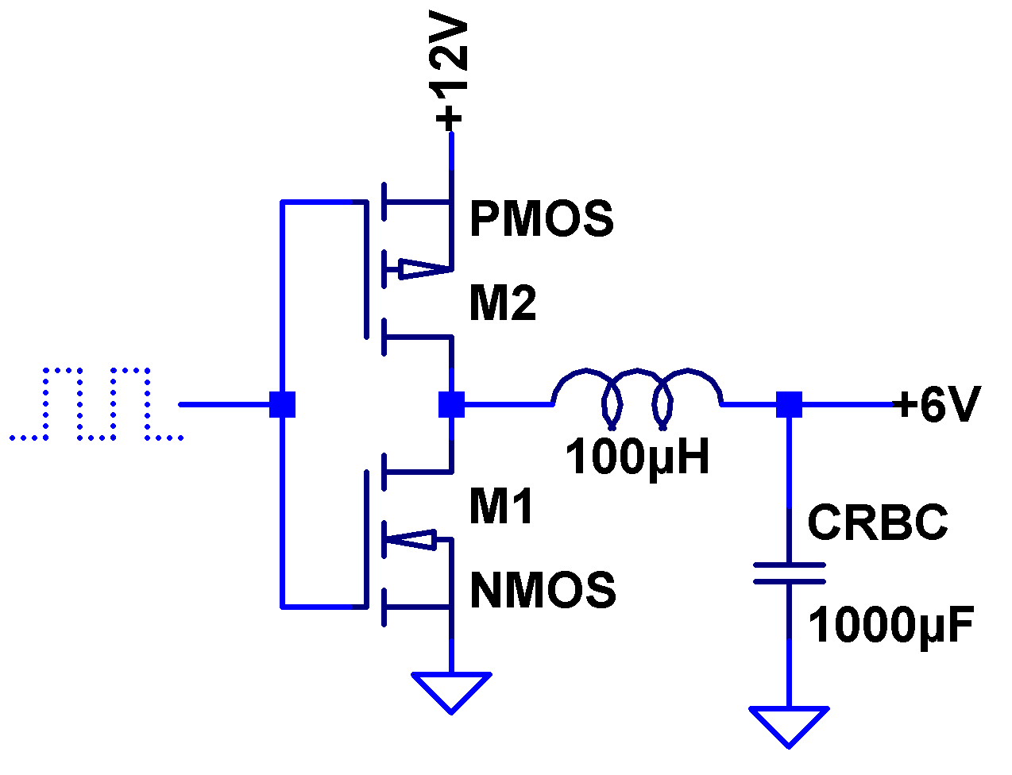
Let’s make one component substitution…
50% duty cycle square wave
NOW we’re getting somewhere!
RBC = Really Big Capacitor

Slide 6
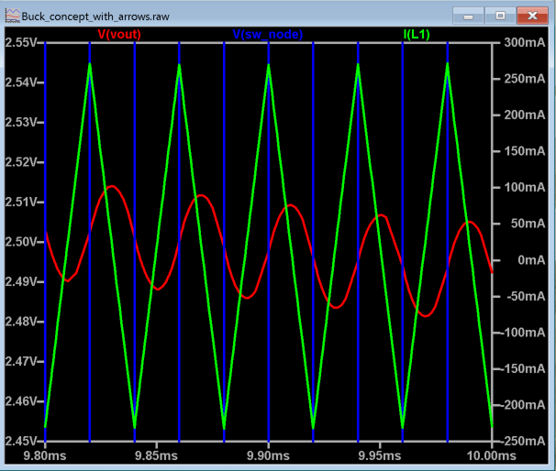
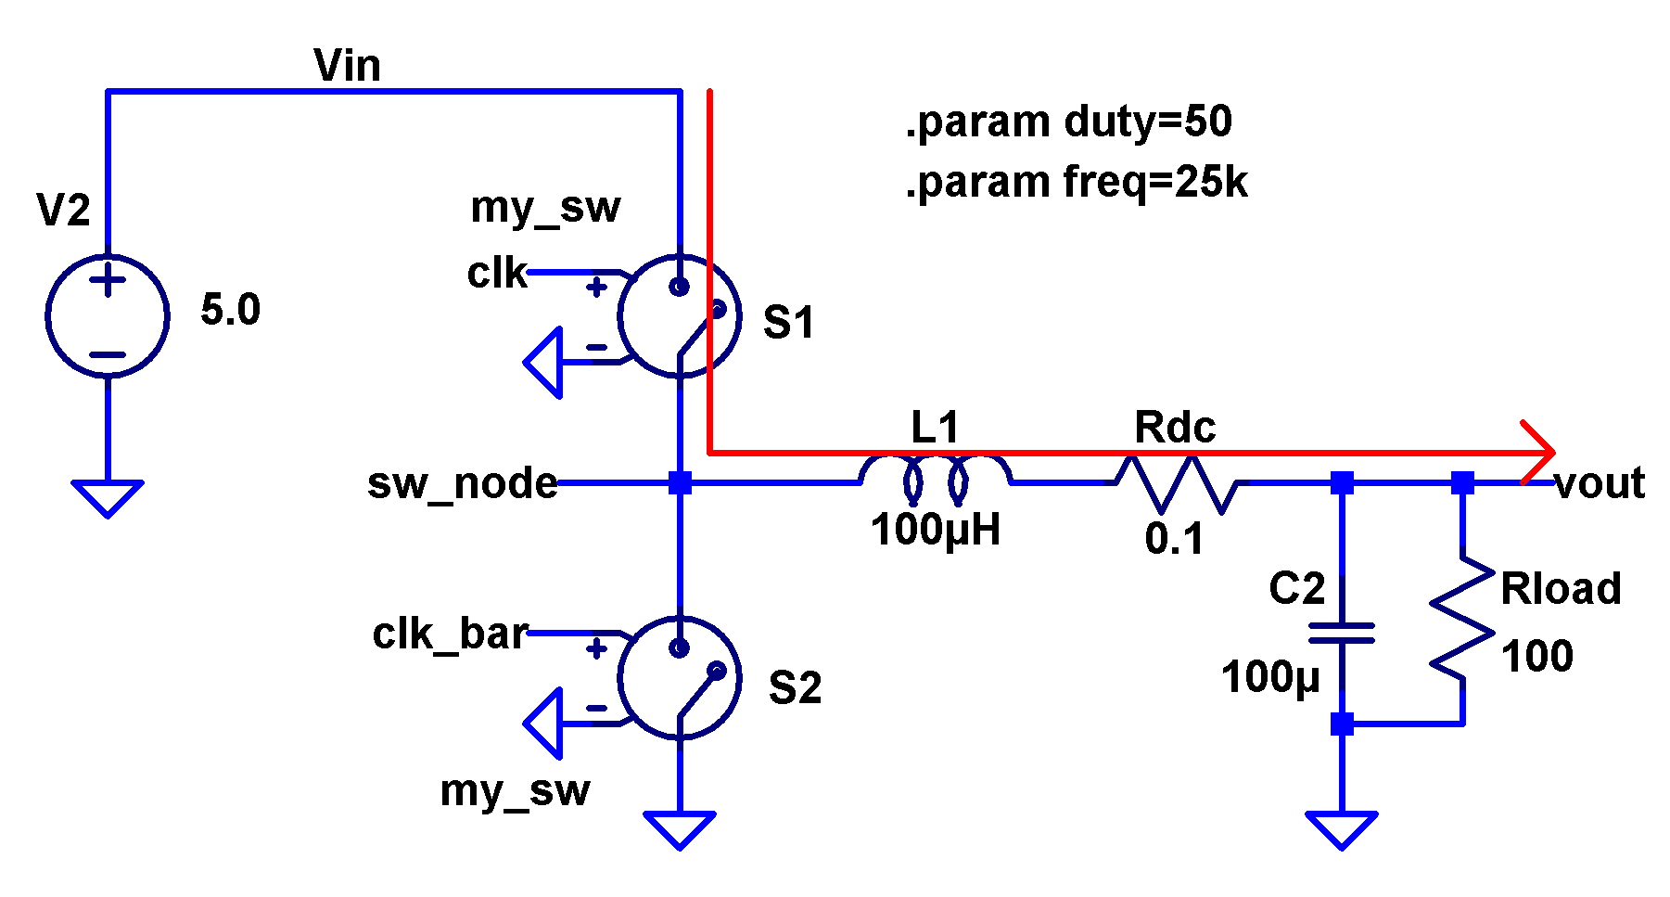
An Ideal-ish buck converter

Slide 7
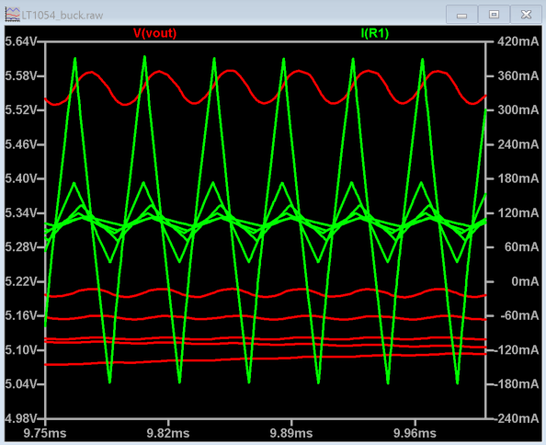
Inductor Value Selection
It’s a compromise:
Higher L = lower ripple current
(Bigger is better!)
Lower L = smaller size
(Smaller is better!)
Higher L = lower switching frequency, less switching loss
(Bigger is better!)
Lower L = higher switching frequency, easier to filter
(Smaller is better!)

Slide 8
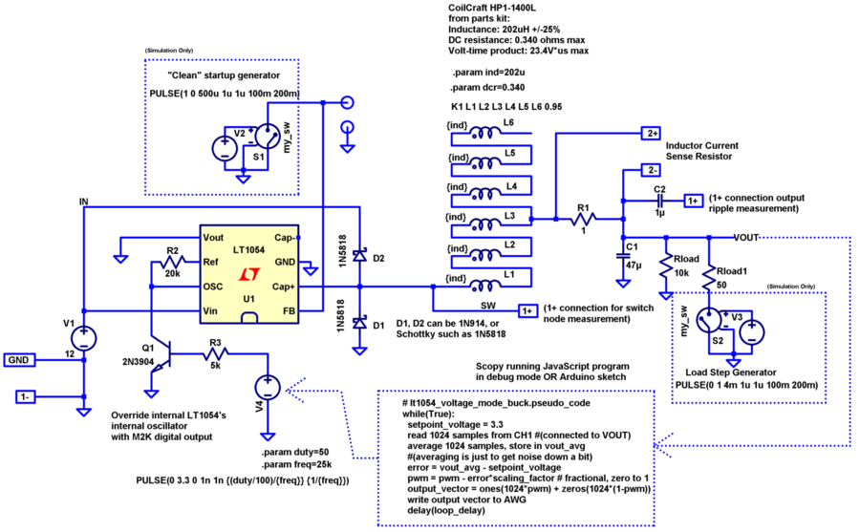
A buck converter we can build from scratch…

Slide 9
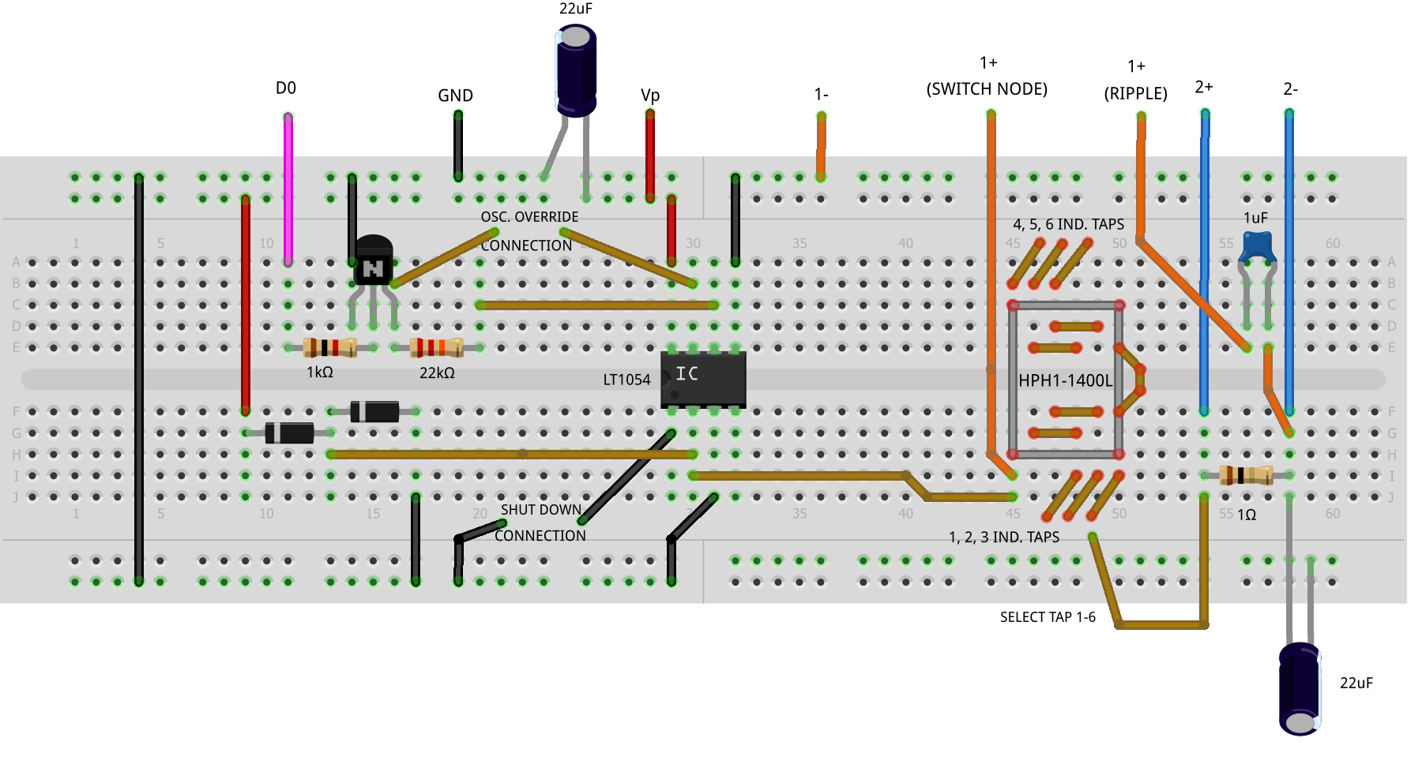
Option 1: Breadboard Construction

Slide 10
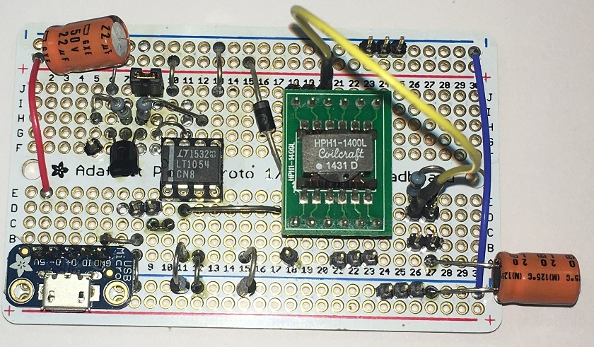
Option 1a: PermaProto construction

Slide 11
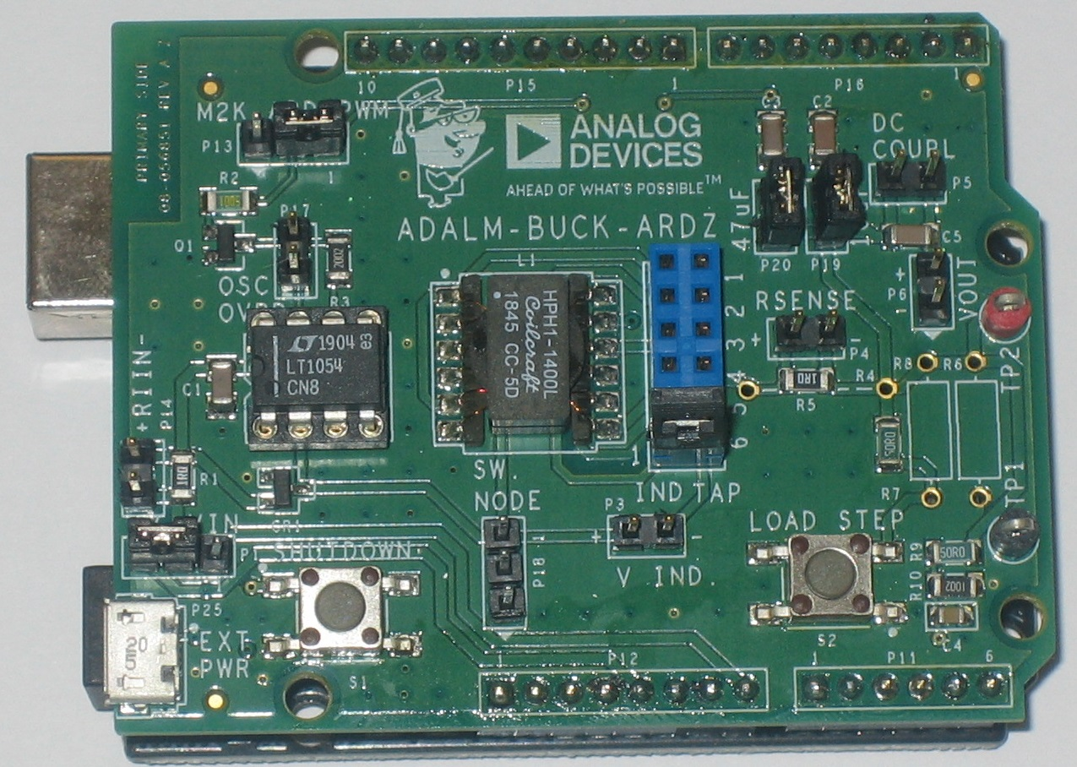
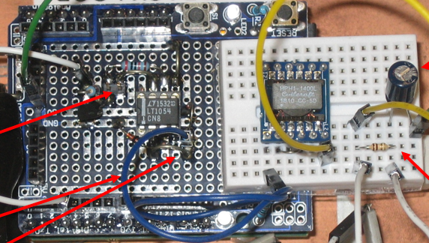
Option 2: ADALM-BUCK-ARDZ
History Lesson: First workshop used hand-soldered modules.
Not practical long term, so we developed the ADALM-BUCK module
(Lab can also be done with breadboards, see Active Learning Wiki page)

Slide 12
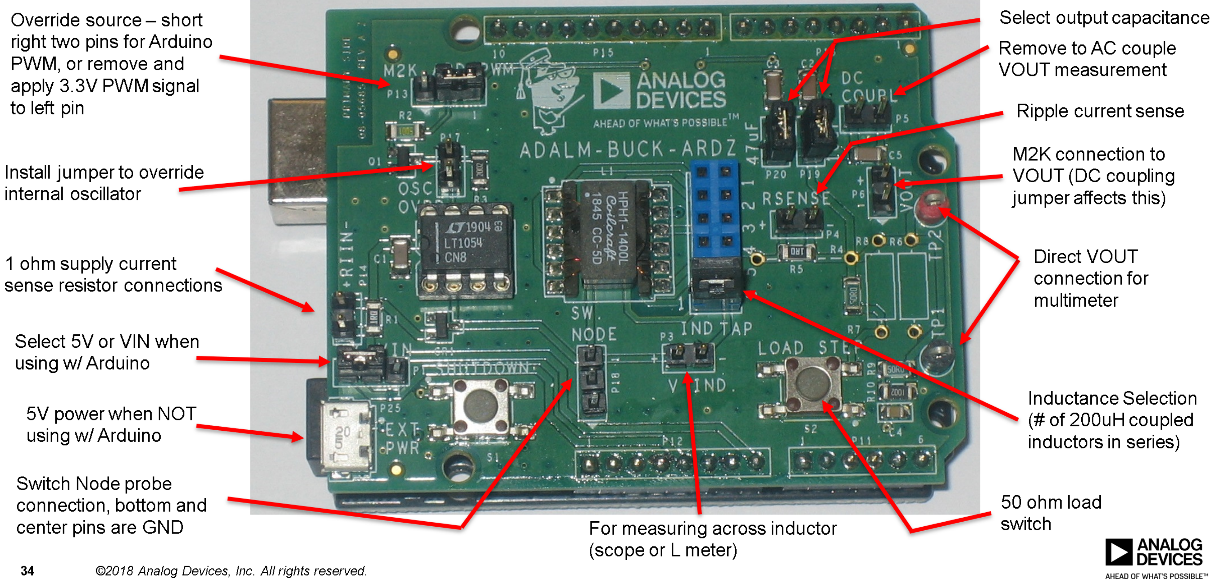
ADALM-BUCK connections (Prototype Rev.)
Print Me!
Ext. pulse source
Select output capacitance
Short to use ext. pulse
Ripple current sense
Inductance Selection: to pin 4,5,6,10,11,12)
50 ohm load switch
Switch Node probe conn.

Slide 13
ADALM-BUCK schematic (Prototype Rev.)
Print Me!

Slide 14
Probing Hints
The ADALM-BUCK board testpoints are designed for ADALM2000 leads, but standard scope probes are also usable.
Clip ground lead to TP1
For ripple current measurement - If you only have a two channel scope, connect CH1 to SW NODE top conductor, set DC coupling, trigger on rising edge, ~2.5V threshold. Set the other channel to AC coupling, and observe both sides of the RSENSE jumper. Convince yourself that most of the “wiggle” shows up at the lefthand (+) side. This is because the righthand side (-) has large bypass capacitors (install both jumpers.) Thus, the ripple current can be inferred from the wiggle at the lefthand side of RSENSE.

Slide 15
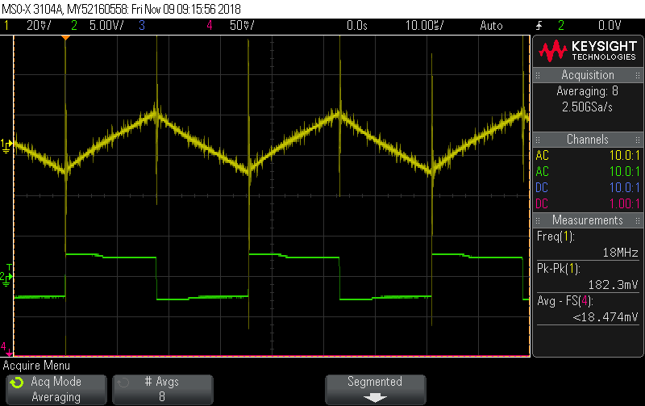
Experiments:
REMOVE OSC OVRD jumper so that duty cycle is fixed 50%
Probe switch node
Probe RSENSE, set scope to AC coupled. Select different inductor taps, observe ripple
Probe downstream side of sense R, measure voltage ripple w/ 22uF, 47uF, 220uF output caps
These are not easy measurements:
Trigger on CH2, switch node
Turn on averaging

Slide 16
Measurement Worksheet – Inductor Ripple Current
Print Me!
# of windings | Inductance (uH) (values measured on example board) | Ripple Current (mA p-p)
1 | 199
2 | 841
3 | 1997
4 | 3730
5 | 6020
6 | 8810
Example data:
# of windings | Inductance (uH) | Calculated Ripple Current (mAp-p) | Measured Ripple Current (mA p-p)
1 | 199 | 210 | 150
2 | 841 | 51 | 43
3 | 1997 | 21 | 21
4 | 3730 | 12 | 15
5 | 6020 | 7.1 | 10
6 | 8810 | 4.9 | 9

Slide 17
Experiment: Output Ripple
Remove DC coupling jumper
Connect M2K 2-, 2+ across VOUT header
Install 10uF jumper only, Measure ripple current
Install 47uF jumper only, Measure ripple current

Slide 18
Measurement Worksheet – Output Ripple
Print Me!
Output Capacitance | Ripple Voltage (mA p-p) 2 inductors | Ripple Voltage (mA p-p) 4 inductors
10uF
47uF
57uF
(Add external caps if you have some lying around)

Slide 19
Closing the loop!
“load” the output with the 47-ohm resistor, note the “droop” in voltage
Upload Arduino sketch:
https://github.com/analogdevicesinc/Linduino/tree/master/LTSketchbook/Active Learning/LT1054_voltage_mode_buck_DC_ctrl
Install PWM control jumper
Connect downstream side of sense R to Arduino A0 (analog input)
Measure output, loaded and unloaded
See if you can catch a “transient dip”
Send “0”, “1”…”7”, “8”, “9”, “A” to set duty cycle to 10%-100% in 10% increments.
Send any other character to return to closed-loop operation.

Slide 20
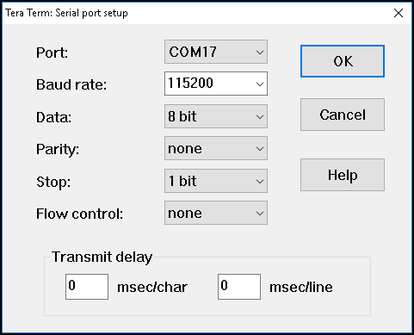
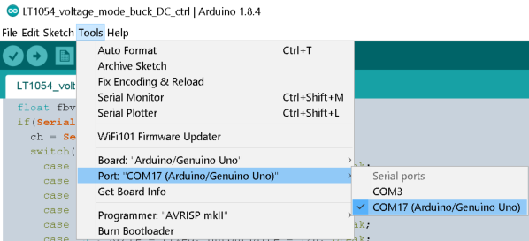
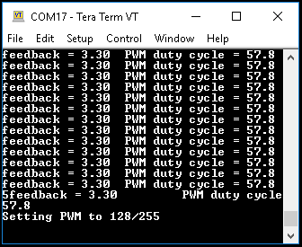
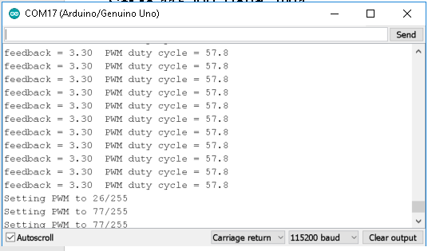
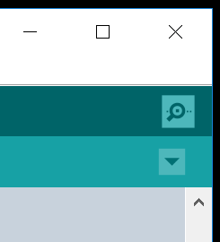
Terminal Setup
EITHER Arduino Serial Debug or TeraTerm will work
You may have several COM ports, trial and error
Set to 115200 Baud, 8N1
For TeraTerm, Run:
ttermpro.exe
For Arduino, click Serial Monitor icon

Slide 21
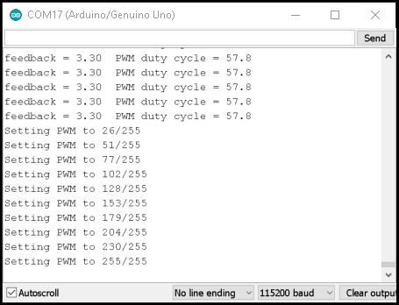
Closing the Loop, Manual duty cycle control
Move jumper from “+RIIN-” to “OSC OVRD”
Install PWM control jumper
Connect downstream side of sense R to Arduino A0 (analog input)
Observe output voltage and duty cycle
Press “LOAD STEP” button, observe duty cycle
Send “0”, “1”…”7”, “8”, “9”, “A” to “open the loop” and set duty cycle to fixed 10%-100% in 10% increments. Observe output voltage.
Send any other character to return to closed-loop operation.

Slide 22
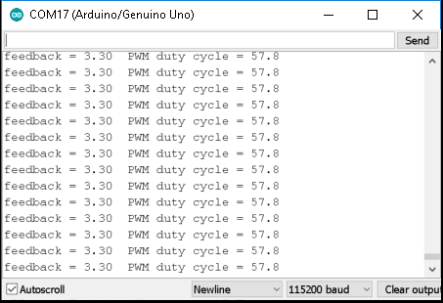
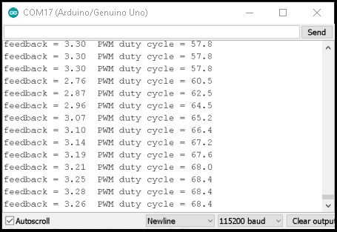
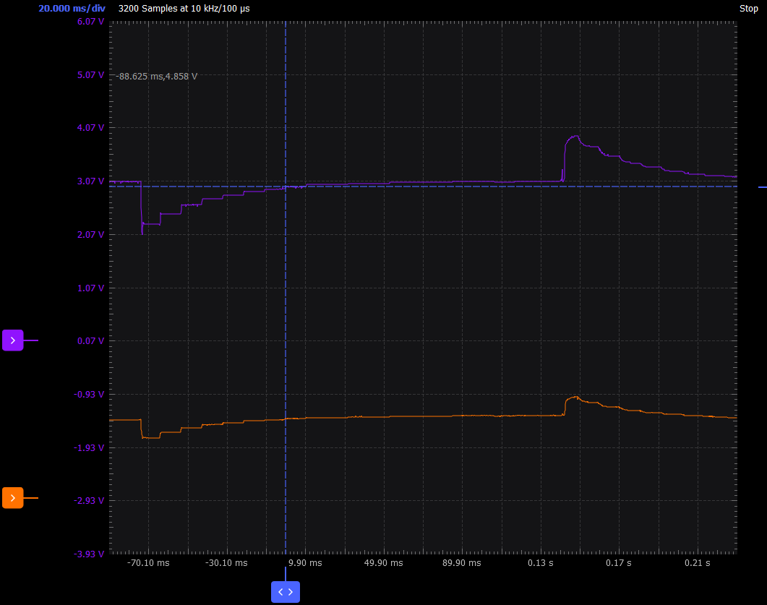
Closed Loop Duty Cycle vs. load
Measure output, unloaded and loaded w/ 49.9 ohm resistor.
See if you can catch a “transient dip”
In serial terminal, note the “droop” in voltage, and corresponding increase in duty cycle to compensate

Slide 23
Acknowledgements

Slide 24
Thanks!

