Slide 1
Low IMD3 Two-tone Signal Generation for ADC linearity Testing
Gunma University
Fumitaka Abe

Slide 2
Outline
Research motivation
Low IMD3 two-tone signal generation
Experimental results
Applied to ADC testing（Under review）
Conclusion
Notes:
This is the outline.
My talk consists of
・Research Motivation.
・Conventional Method
・Proposed Method
・Experimental Results
・Extension to ΔΣDAC
And ・Conclusion

Slide 3
Outline
Research motivation
Low IMD3 two-tone signal generation
Experimental results
Applied to ADC testing（Under review）
Conclusion
Notes:
This is the outline.
My talk consists of
・Research Motivation.
・Conventional Method
・Proposed Method
・Experimental Results
・Extension to ΔΣDAC
And ・Conclusion

Slide 4
Research Motivation
Low distortion two-tone signal generation
for ADC testing with low cost AWG
by only changing DSP program
Conventional
Proposed
AWG
ADC
AWG
ADC
DUT
DSP program
change
DUT
IMD3
IMD3
IMD3
IMD3
Low quality test signal
High quality test signal

Slide 5

Two-Tone Signal Generation with AWG
AWG
Nonlinear
Nonlinear
$$D_{in}$$
Y
DSP
DAC
ADC
Digital
Signal
Analog
Signal
DUT
High IMD3
Low quality test
IMD3
IMD3
IMD3
IMD3
Notes:
This slide shows two-generation with AWG.
First of all we use two-tone test signal because communication application ADC receives narrow band signal.
AWG consists of DSP and DAC.
DSP generates digital signal Din and DAC converts it to analog signal Y.
The internal DAC of the AWG is Nonlinearity.
So, the output of the AWG includes high IMD3.
This is test signal for ADC.
The output of the ADC is here.
The IMD3 of the AWG is large compared with the ADC.
So, this is a low quality test.

Slide 6

















IMD3 is important for Two-tone Signal ！
$$D_{in}$$
Nonlinear Time Invariant System
$$Y$$
$Y=$ $a_{0}+a_{1}D_{in}+a_{2}{D_{in}}^{2}+a_{3}{D_{in}}^{3}+・・・$
$$f_{1}$$
$$f_{2}$$
Analog Filter
Two-tone
signal
IMD3
IMD3
$$DC$$
$$f_{1}$$
$$f_{2}$$
$${2f}_{1}$$
$${2f}_{2}$$
$${3f}_{1}$$
$${3f}_{2}$$
$$f_{2}−f_{1}$$
$${2f}_{2}−f_{1}$$
$$f_{1}+f_{2}$$
$${2f}_{1}+f_{2}$$
$${2f}_{1}−f_{2}$$
$${2f}_{2}+f_{1}$$
Hardly to remove with analog filter
Notes:
IMD3 is the most important component when f1 nearly equal f2 Two-tone Signal is input to the Nonlinearity System.
Because IMD3 is very close to fundamental wave f1 and f2.
So, we cannot remove this component with analog filter.
In the following slides I consider IMD3 is the dominant system.
That is third order Nonlinearity system.

Slide 7
Outline
Research motivation
Low IMD3 two-tone signal generation
Experimental results
Applied to ADC testing（Under review）
Conclusion
Notes:
This is the outline.
My talk consists of
・Research Motivation.
・Conventional Method
・Proposed Method
・Experimental Results
・Extension to ΔΣDAC
And ・Conclusion

Slide 8








Conventional Test Signal with AWG
AWG
Nonlinear
$Y=$ $a_{1}D_{in}+a_{3}{D_{in}}^{3}$
Digital Input
$$D_{in}$$
Analog Output
$$Y$$
DSP
DAC
CLK
CLK
$$D_{in}$$
$$X$$
$$X$$
$$X$$
$$X$$
$$X=A・cos\left(2πf_{1}nT_{s}\right)+A・cos⁡(2πf_{2}nT_{s})$$
Notes:
Conventional test signal Din consists of only X.
X is this two-tone signal.

Slide 9









IMD3 appear
AWG
Nonlinear
Digital Input
$$D_{in}$$
Analog Output
$$Y$$
DSP
DAC
CLK
CLK
$$D_{in}$$
$$X$$
$$X$$
$$X$$
$$X$$
$${2f}_{1}+f_{2}$$
$${2f}_{1}−f_{2}$$
$${2f}_{2}−f_{1}$$
$${2f}_{2}+f_{1}$$
$${3f}_{1}$$
$${3f}_{2}$$
IMD3
IMD3
$$f_{1}$$
$$f_{2}$$
$$f_{s}/2$$
IMD3 components appear
Notes:
The output of the DAC is here.
IMD3 components appear because of nonlinearity DAC.

Slide 10




Proposed Test Signal with AWG
AWG
Nonlinear
Digital Input
$$D_{in}$$
Analog Output
$$Y$$
DSP
DAC
CLK
CLK
$$D_{in}$$
$$X_{0}$$
$$X_{1}$$
$$X_{0}$$
$$X_{1}$$
Phase Switching Test Signal
$$X_{0}=A・cos\left(2πf_{1}(2n−1)T_{s}\right)+A・cos\left(2πf_{2}{\left(2n−1\right)T}_{s}+\frac{π}{3}\right)$$
$$X_{1}=A・cos\left(2πf_{1}{(2n)T}_{s}+\frac{π}{3}\right)+A・cos⁡(2πf_{2}{(2n)T}_{s})$$

Slide 11
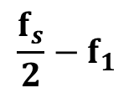



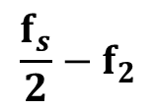

IMD3 disappear
AWG
Nonlinear
Digital Input
$$D_{in}$$
Analog Output
$$Y$$
DSP
DAC
CLK
CLK
$$D_{in}$$
$$X_{0}$$
$$X_{1}$$
$$X_{0}$$
$$X_{1}$$
Switching Spurious appear
far from Signal
$${2f}_{1}+f_{2}$$
$${2f}_{1}−f_{2}$$
$${2f}_{2}−f_{1}$$
$${2f}_{2}+f_{1}$$
$${3f}_{1}$$
$${3f}_{2}$$
$$\frac{f_{s}}{2}−f_{2}$$
$$\frac{f_{s}}{2}−f_{1}$$
IMD3
IMD3
$$f_{1}$$
$$f_{2}$$
$$f_{s}/2$$
IMD3 are canceled

Slide 12












Conv. and Prop. Two-tone Test Signal
$$f_{1}$$
$$f_{2}$$
$${2f}_{1}−f_{2}$$
$${2f}_{2}−f_{1}$$
$${3f}_{1}$$
Conventional
$${3f}_{2}$$
$$f_{1}$$
$$f_{2}$$
$$f_{s}/2−f_{1}$$
$$f_{s}/2−f_{2}$$
$${2f}_{1}+f_{2}$$
$${2f}_{2}+f_{1}$$
Proposed
Notes:
f1 = 81,f2 = 131,fs = 4096

Slide 13


Proposed Low IMD3 Two-tone Generation
AWG
DSP Program Change
Nonlinear
$$D_{in}$$
DSP
DAC
CLK
CLK
$$D_{in}$$
- No hardware change
- No need for DAC nonlinearity identification
- No need for calibration
Notes:
I supposed four proposed technic to generate low IMD3 test signal.
We just only change the DSP program.
So, there is no need for hardware change, DAC nonlinearity identification, and calibration.

Slide 14
Outline
Research motivation
Low IMD3 two-tone signal generation
Experimental results
Applied to ADC testing（Under review）
Conclusion
Notes:
This is the outline.
My talk consists of
・Research Motivation.
・Conventional Method
・Proposed Method
・Experimental Results
・Extension to ΔΣDAC
And ・Conclusion

Slide 15
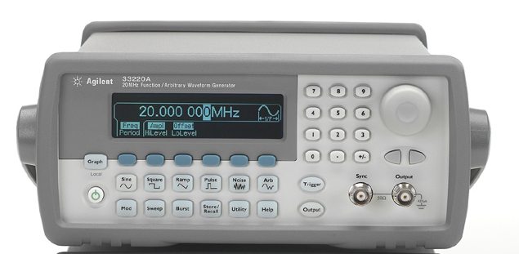
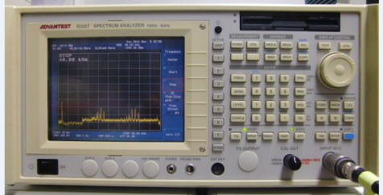
Experimental Conditions
AWG
Spectrum analyzer
Signal
Agilent 33220A
ADVANTEST R3267
Frequency characteristic
1μHz~6MHz
Frequency band
100Hz~8GHz
Amplitude Resolution
14bits
RBW
10Hz~30MHz
Maximum Sampling Rate
50MSa/s
※ RBW : Resolution Band Width
Test Signal
Two-tone Signal
200kHz , 220kHz
Sampling rate
10MSa/s
Input Voltage
0.8~2.0Vpp (0.2Vstep)
Offset
0

Slide 17
Outline
Research motivation
Low IMD3 two-tone signal generation
Experimental results
Applied to ADC testing（Under review）
Conclusion
Notes:
This is the outline.
My talk consists of
・Research Motivation.
・Conventional Method
・Proposed Method
・Experimental Results
・Extension to ΔΣDAC
And ・Conclusion

Slide 18
ADC Test System using Proposed Signal
AWG
3rd-order
3rd-order
Nonlinear
Nonlinear
Din
Aout
Ain
Dout
DSP
DAC
ADC

Slide 19
ADC Test System using Proposed Signal
AWG
3rd-order
3rd-order
Nonlinear
Nonlinear
Din
Aout
Ain
Dout
DSP
DAC
ADC

Slide 20
LPF
AWG
3rd-order
3rd-order
Nonlinear
Nonlinear
Din
Aout
Ain
Dout
DSP
DAC
LPF
ADC

Slide 21
LPF
AWG
3rd-order
3rd-order
Nonlinear
Nonlinear
Din
Aout
Ain
Dout
DSP
DAC
LPF
ADC

Slide 22














Phase Switching spurious Reducing ?
Phase Switching
Two-tone Signal
3rd-order
Nonlinear System
$$f_{1}$$
$$f_{2}$$
IMD3 level
$$f_{1}$$
$$f_{2}$$
LPF
3rd-order
$$f_{s}/2−f_{2}$$
Nonlinear System
$$f_{1}$$
$$f_{2}$$
$$f_{s}/2−f_{1}$$
$$f_{s}/2−f_{2}$$
$$f_{s}/2−f_{1}$$
Conventional
Two-tone Signal
IMD3 level
LPF
3rd-order
Nonlinear System
$$f_{1}$$
$$f_{2}$$
$$f_{1}$$
$$f_{2}$$

Slide 23
IMD3 Error [%]
Attenuation of Switching Spurious using LPF [dB]

Slide 24
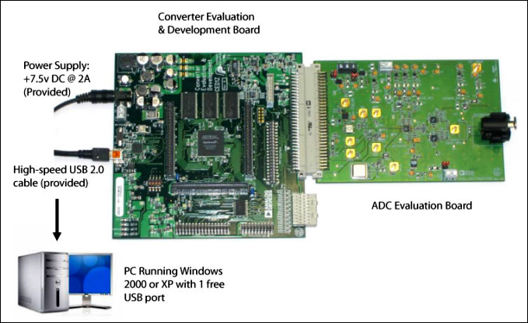

Test System for ADC
EVAL-CED1Z
EVAL-AD7266EDZ
Converter Evaluation and
Development Board
EVAL-AD7266EDZ
ADC
AD7266
Power
Supply
AWG
AD7265
12bits SAR ADC
30,50kHz
Evaluation Board
Phase Switching
Two-tone Signal
PC
http://www.analog.com/jp/analog-to-digital-converters/ad-converters-ad7265
-products/EVAL-AD7265/evaluation-eb_AD7266_AD7265/fca.html
Notes:
http://www.analog.com/jp/analog-to-digital-converters/ad-converters/ad7265/products/EVAL-AD7265/evaluation/eb_AD7266_AD7265/fca.html

Slide 25
Outline
Research motivation
Low IMD3 two-tone signal generation
Experimental results
Applied to ADC testing（Under review）
Conclusion
Notes:
This is the outline.
My talk consists of
・Research Motivation.
・Conventional Method
・Proposed Method
・Experimental Results
・Extension to ΔΣDAC
And ・Conclusion

