Slide 1
ADXL367 Eval Software Quick Start Guide
Brock Bearss

Slide 2
ADXL367 Eval Software Quick Start
Plot: XYZ Acceleration vs Samples
Register Map Snapshot
Register Settings Configuration
Click to update register map
Click to Start streaming data
Click to Stop streaming data
Perform hardware reset (5 sec)
Exit program
Not functional. Will be updated in future revision.
Perform software reset

Slide 3
Device Overview Tab
On each tab, the Start Data Acquisition and Stop Data Acquisition buttons are the primary ways the user acquires data from the device.
Device Overview Tab
View acceleration data, read the device memory map, and adjust device settings
The ADXL367 evaluation environment is divided into separate tabs, each of which specializes in commonly performed measurements for accelerometer devices.
In this way, the evaluation system offers users an immediate ability to capture data for a wide variety of tests without the need to develop a customized hardware and software solution.
Additional functionality on this tab includes the ability to read the memory register or to take a snapshot of the current memory register values.
Clicking the Read Register Map button gives a snapshot of the current memory register values, and it updates the serial number, device ID, part ID, and Rev ID.

Slide 4
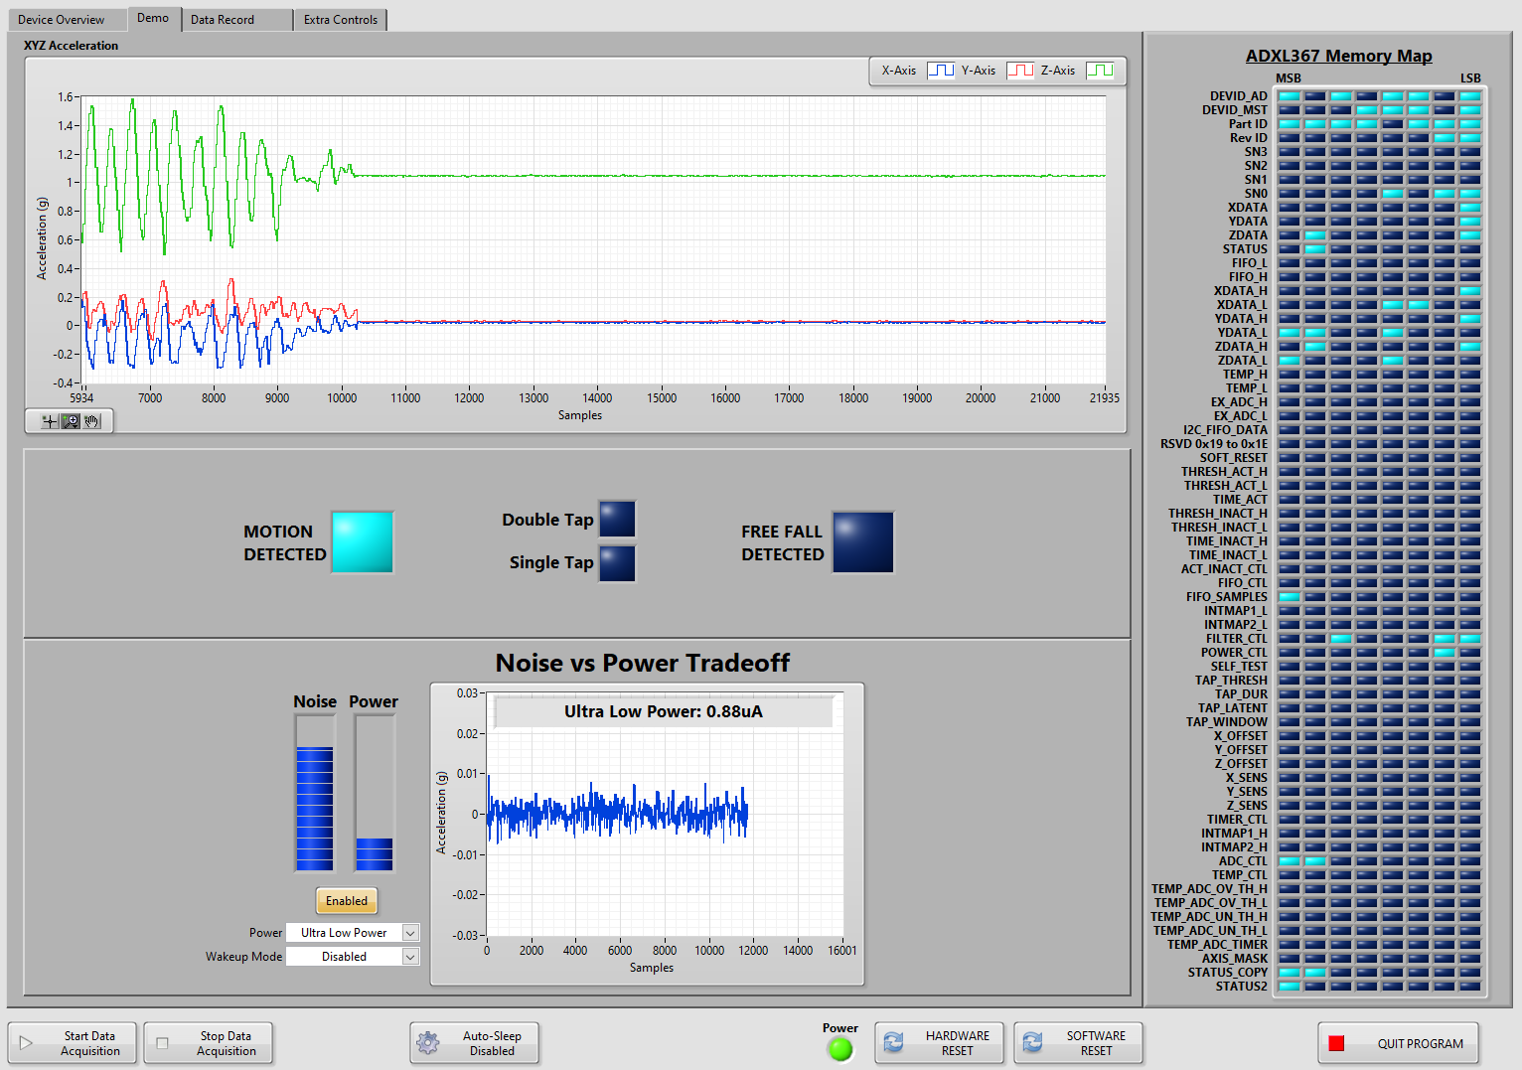
Demo Tab
Demo Tab
Used to explore the various built-in modes that the ADXL367 offers
Motion-activated Wakeup Mode
Single/Double Tap Detection Mode
Freefall Detection Mode
Used to explore effect of modes on noise
Ultralow power vs Ultralow noise mode comparison
Wakeup mode enabled vs disabled noise comparison

Slide 5
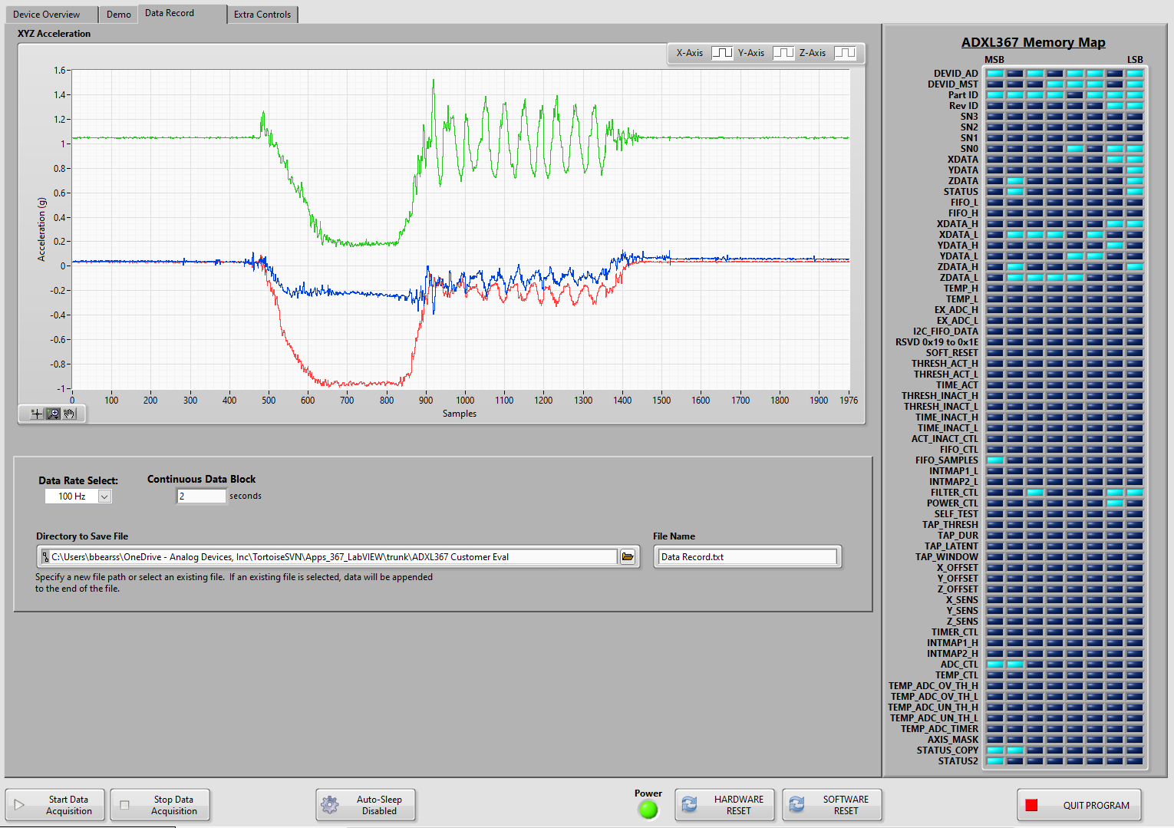
Data Record Tab
Data Record Tab
Measure and record acceleration sampled at the selected output data rate
Data results are saved to a text file with the date, time, device ID, and serial number recorded as a header.
Specify the file path by clicking the small folder icon under Directory to Save File and browsing to the desired folder
If an existing file is selected, data is appended to the end of the file. The user can choose a data rate from 12.5 Hz to 400 Hz with the Data Rate Select control

Slide 6
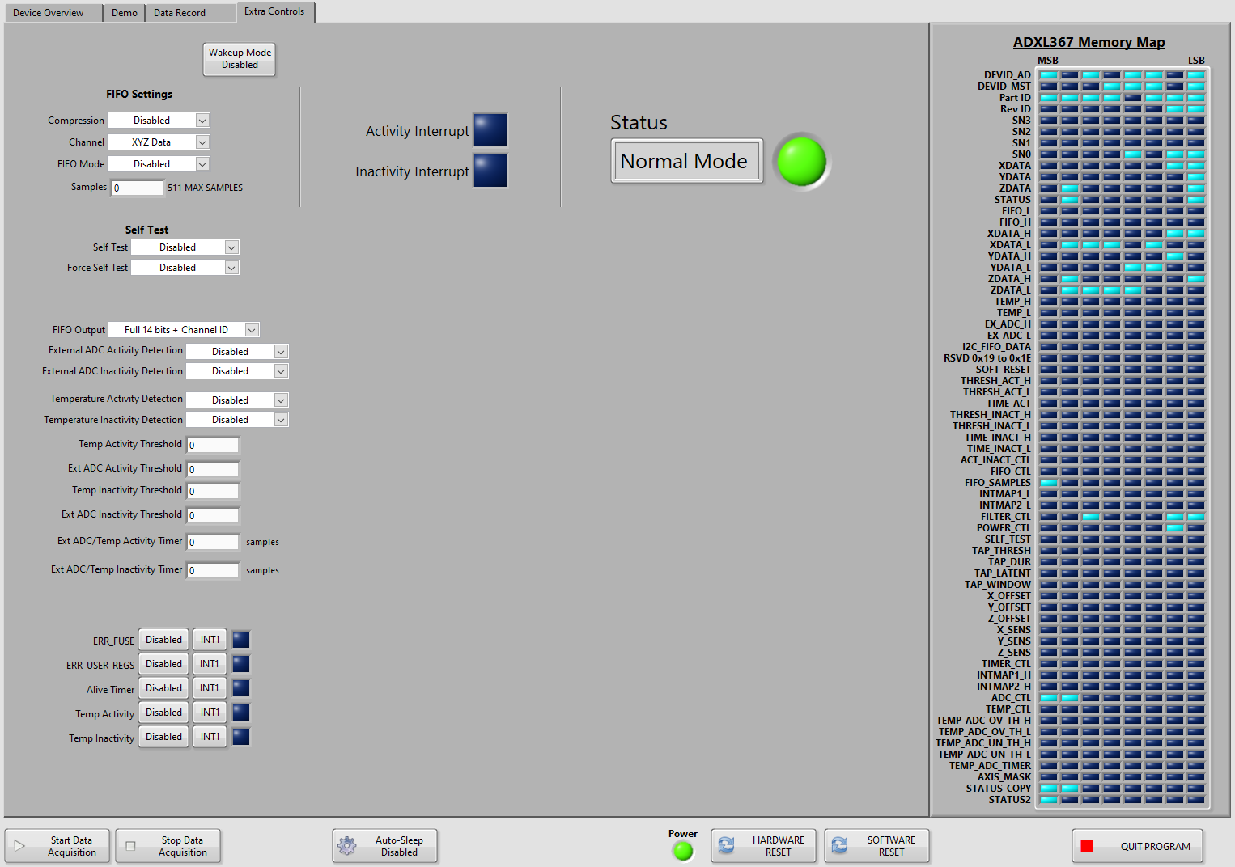
Extra Controls Tab
Extra Controls Tab
Used to configure other register settings (additional to those found in the Device Overview tab)
Work in progress
Some controls may not be implemented yet

